Slide 1
ITEC100
Tutor: Dr. Farshid Keivanian

Slide 2
Week 1: Tutorial activities: Complete the following activities.
Install MS Office (Navigate to office.com and log in with your ACU credentials for FREE download
Sign up for an account on GmetrixLinks to an external site.. Use the ACU email starting with your Student ID (e.g. Sxxxxxxxx): Sxxxxxx@myacu.edu.au for the email address field. The username should be your student ID.
In Gmetrix, click on the Redeem Code on the left panelRedeem access codes (Access codes are posted in the announcement forum)
Navigate to the "Excel 365 Apps (MO-210)" course
Navigate to the “Domain 1: Manage Worksheets and Workbooks” Module.
Complete all learning activities, exercises and Practice Labs of Domain 1.
Complete “Domain 1 Post Assessment”. Take a screenshot of the score page at the end of post assessment.
Submit
Submit the screenshot of the “Domain 1 Post Assessment" score via the week 1 submission box. Make sure your name is visible in the screenshots.

Slide 3
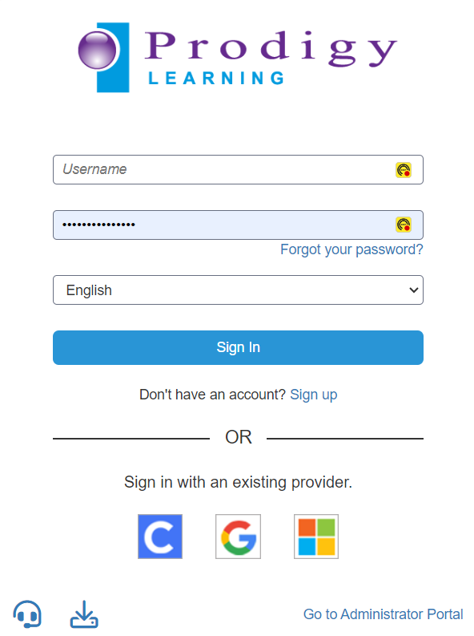
Create an account with GMetrix : https://prodigy.gmetrix.net/
GMETRIX based on Microsoft

Slide 4
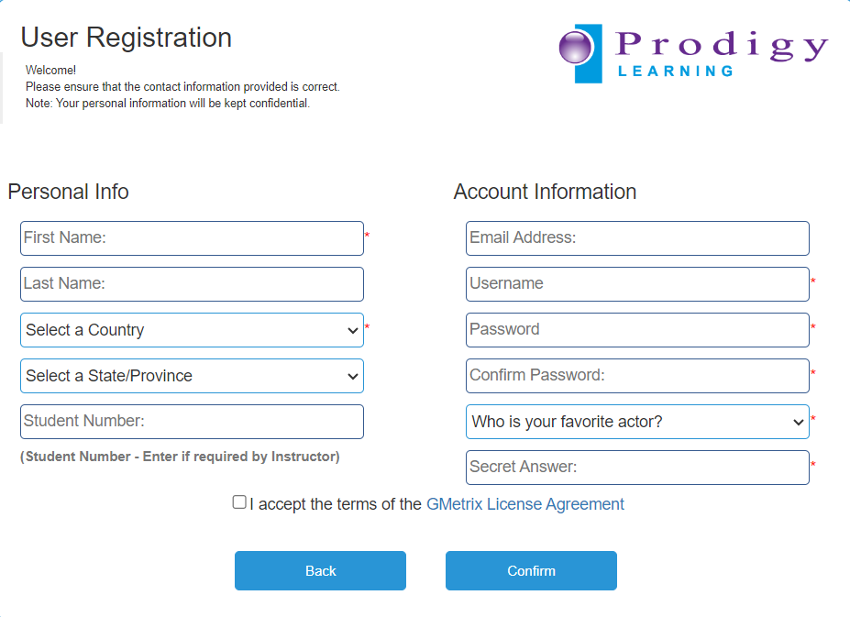
Use the ACU email of this format Sxxxxxx@myacu.edu.au for the email address field. Username should be your student ID Sxxxxxxxx.

Slide 5
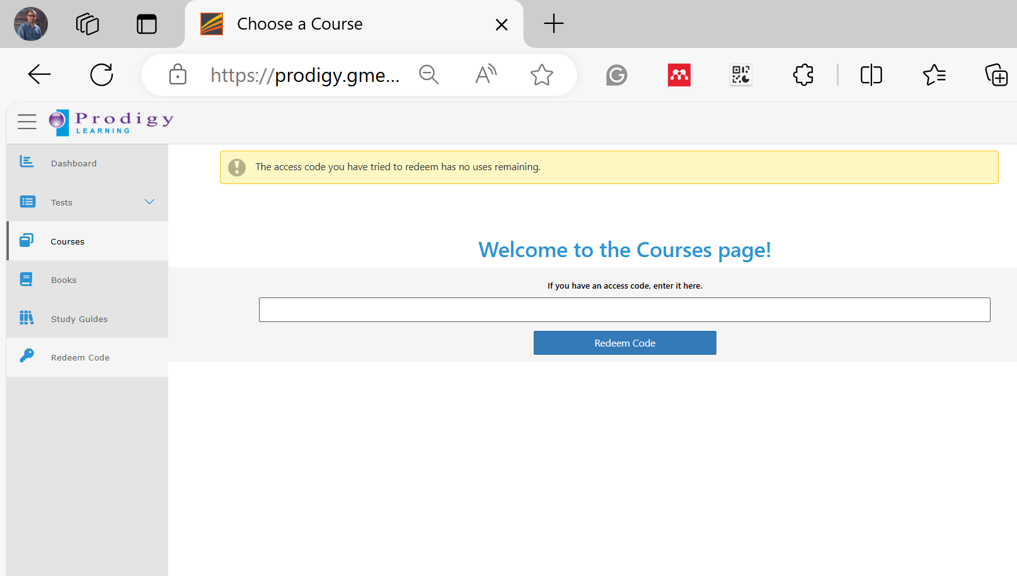
Click on the Redeem Code on the left panel
Redeem the Learn key code (to be used in weeks1-5) and Practice exam code (weeks6-10).
The key for learning materials and practice exam are available on Canvas
Announcement >> Code - North Sydney

Slide 6
There are 3 practice exams that are like the Certiport exam. You need to complete the practice exam and upload the activity report showing a pass in the submission link in weeks 8, 9 and 10.

Slide 7
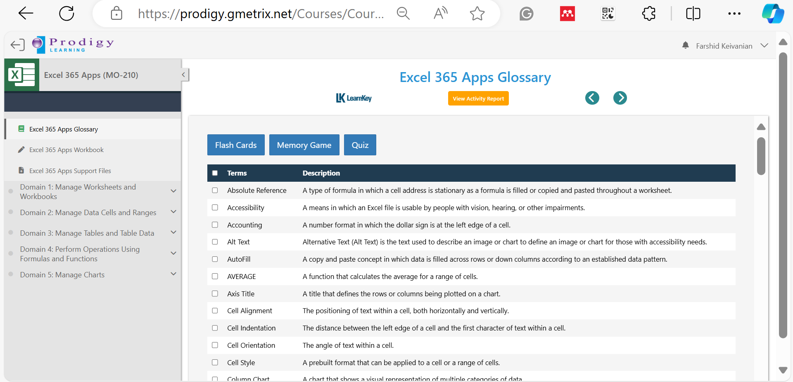
Excel 365 App

Slide 8
Domains 1 to 5 (Weeks 1 to 5) – Each week we do one of them

Slide 9
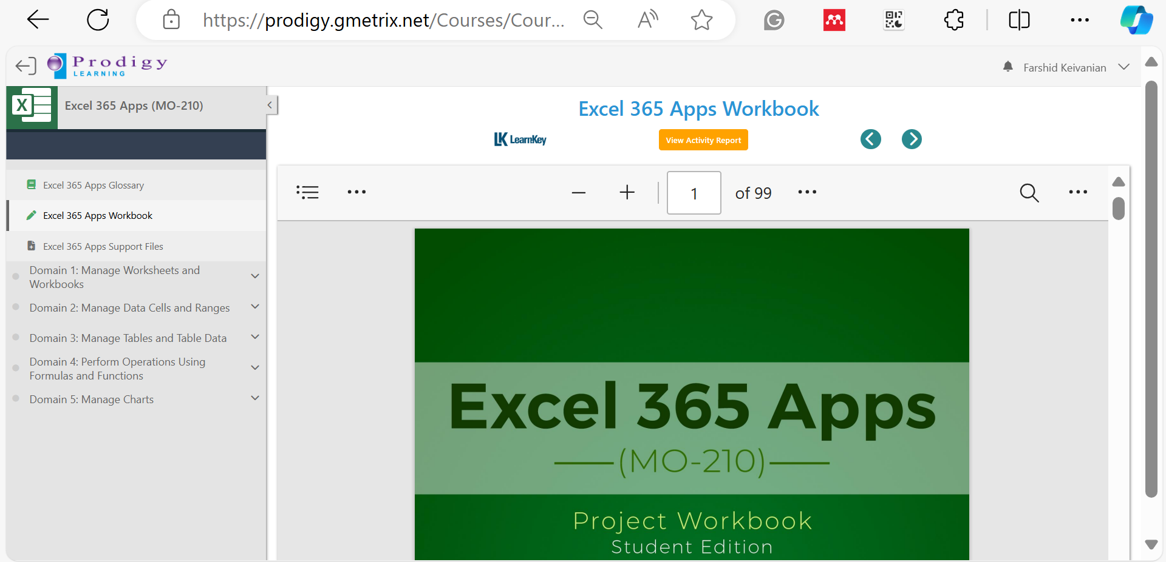
Project Workbook details of each part with examples (start of class)

Slide 10
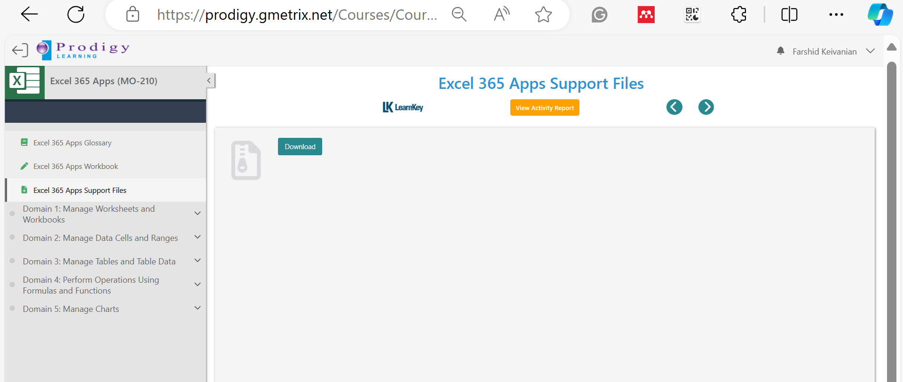
Support Files are used for the Examples

Slide 11
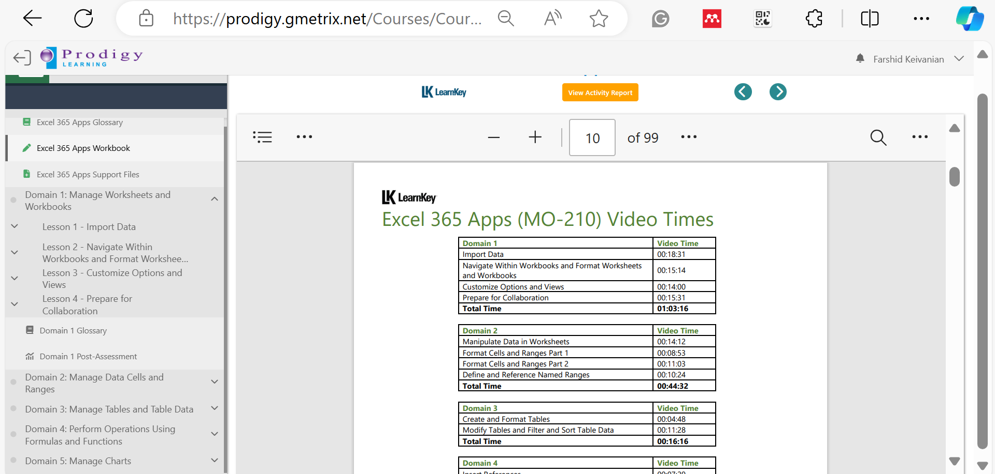
See Videos at Home and Do Post Assessments during Tutorials
Take screenshot of your Test Results (E.g., 100%) and Submit it Online

Slide 12
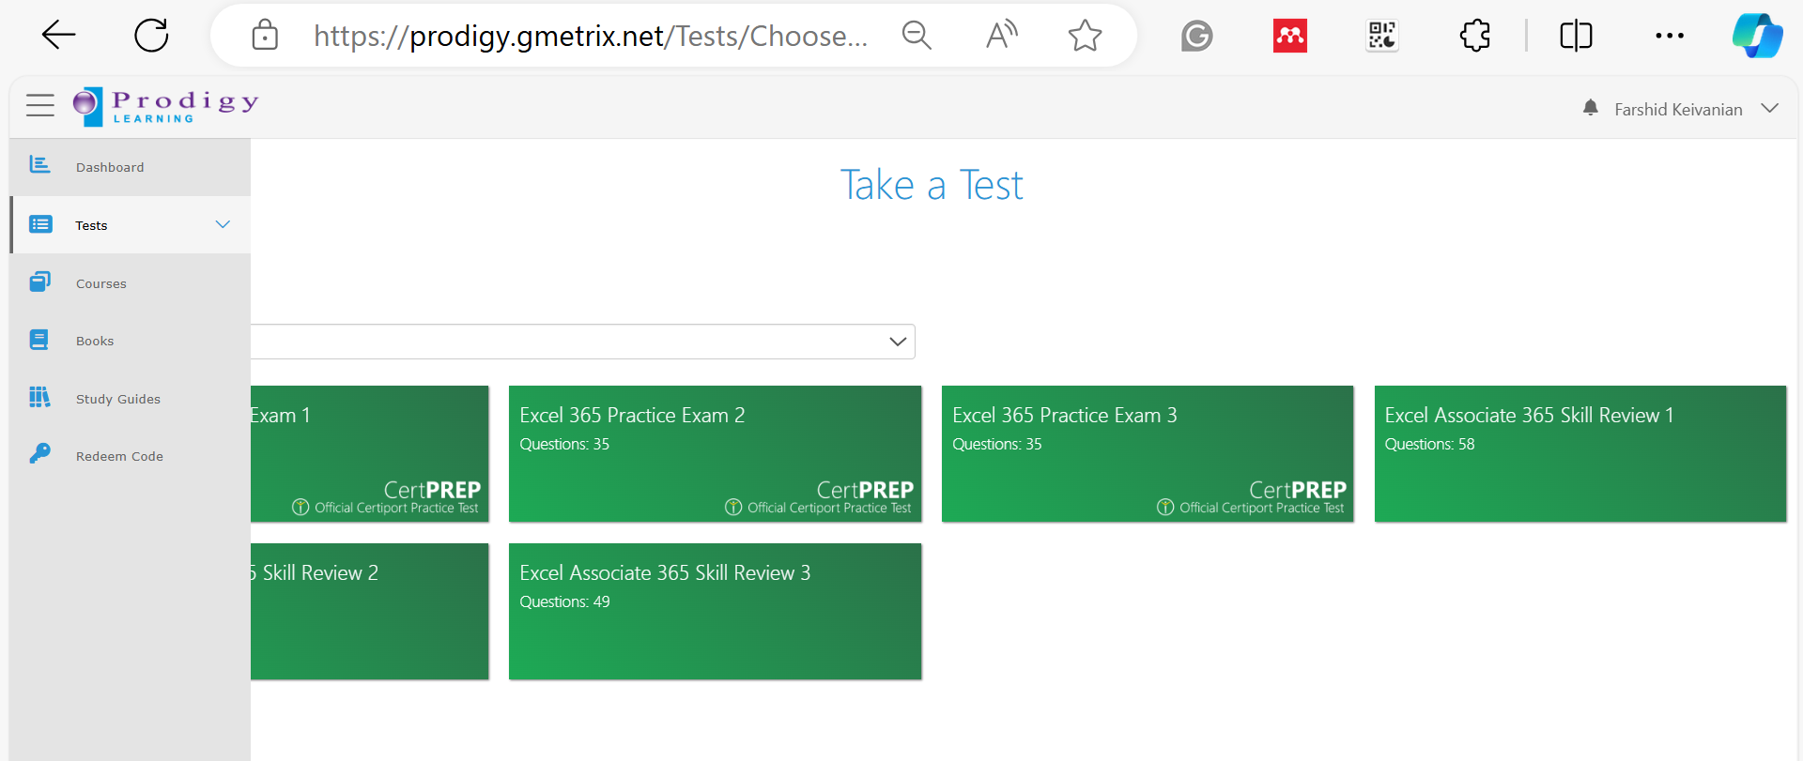
Practice exams are simulations of real exams – During Week 6 (Practice Exam 1)

Slide 13
Presentation record on Power Point

Slide 14
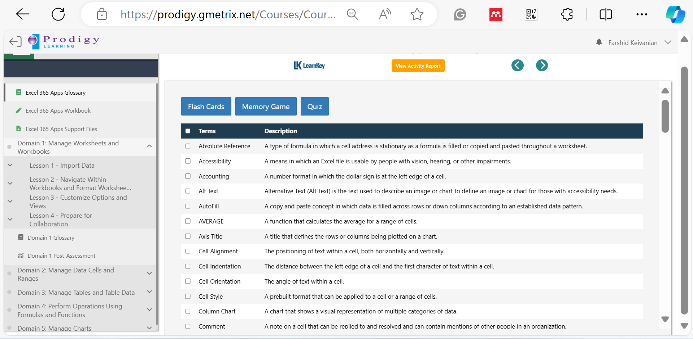
Week 1: Domain 1 - Lessons 1 to 3
Domain 1 Post-Assessment

Slide 15
Special Consideration Form: Canvas >> Assessments >> Special Consideration Form
Textbooks as for references might be helpful for Quiz preparation

Slide 16
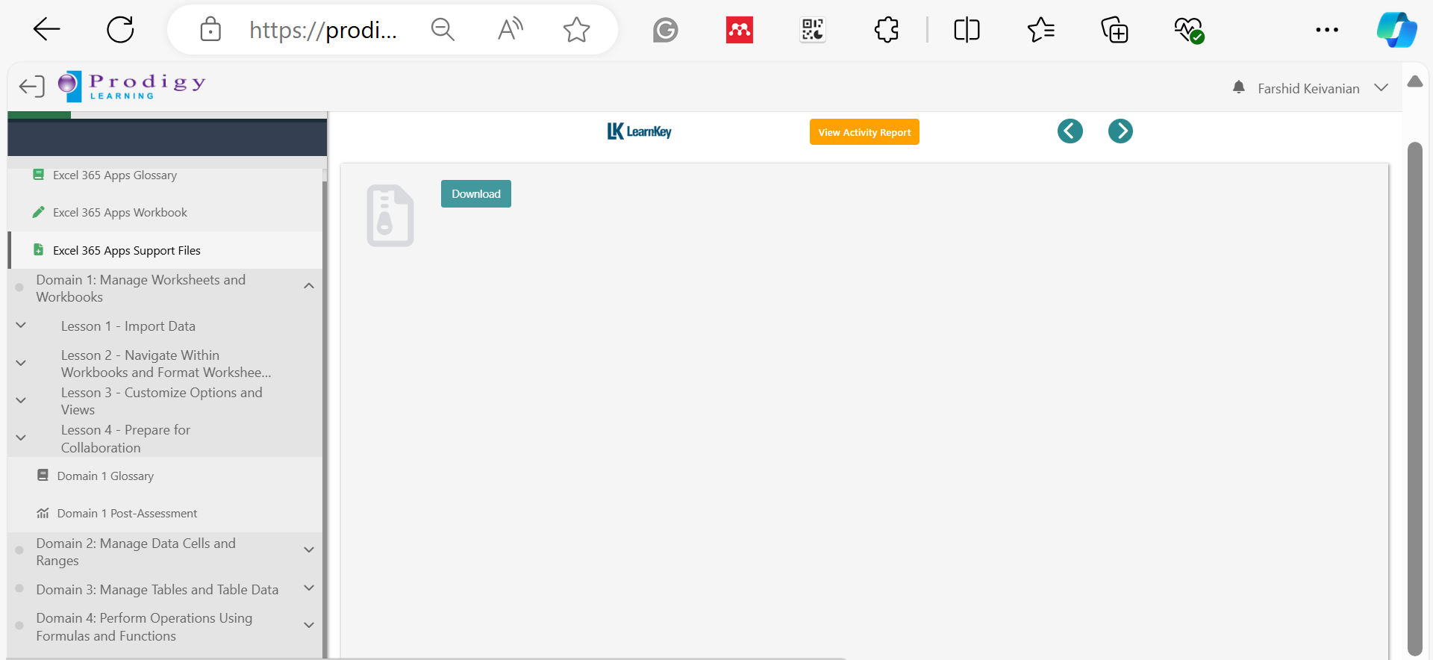
Excel 365 Apps Support Files >> Download

Slide 17
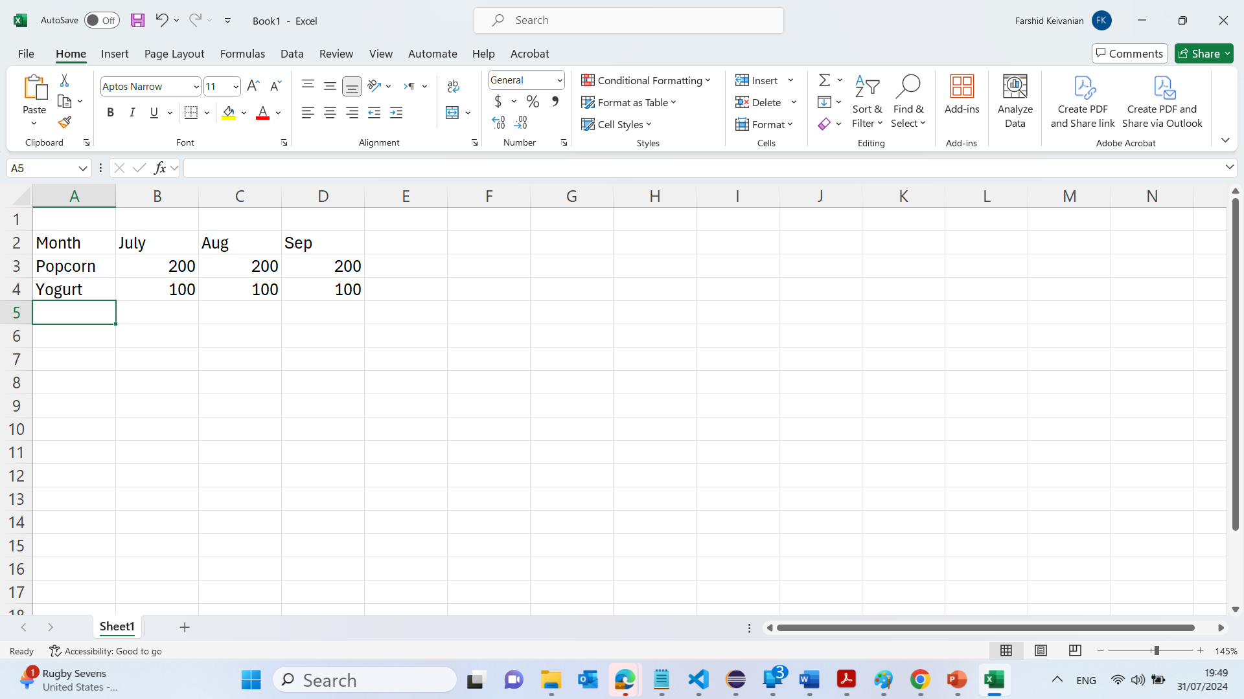
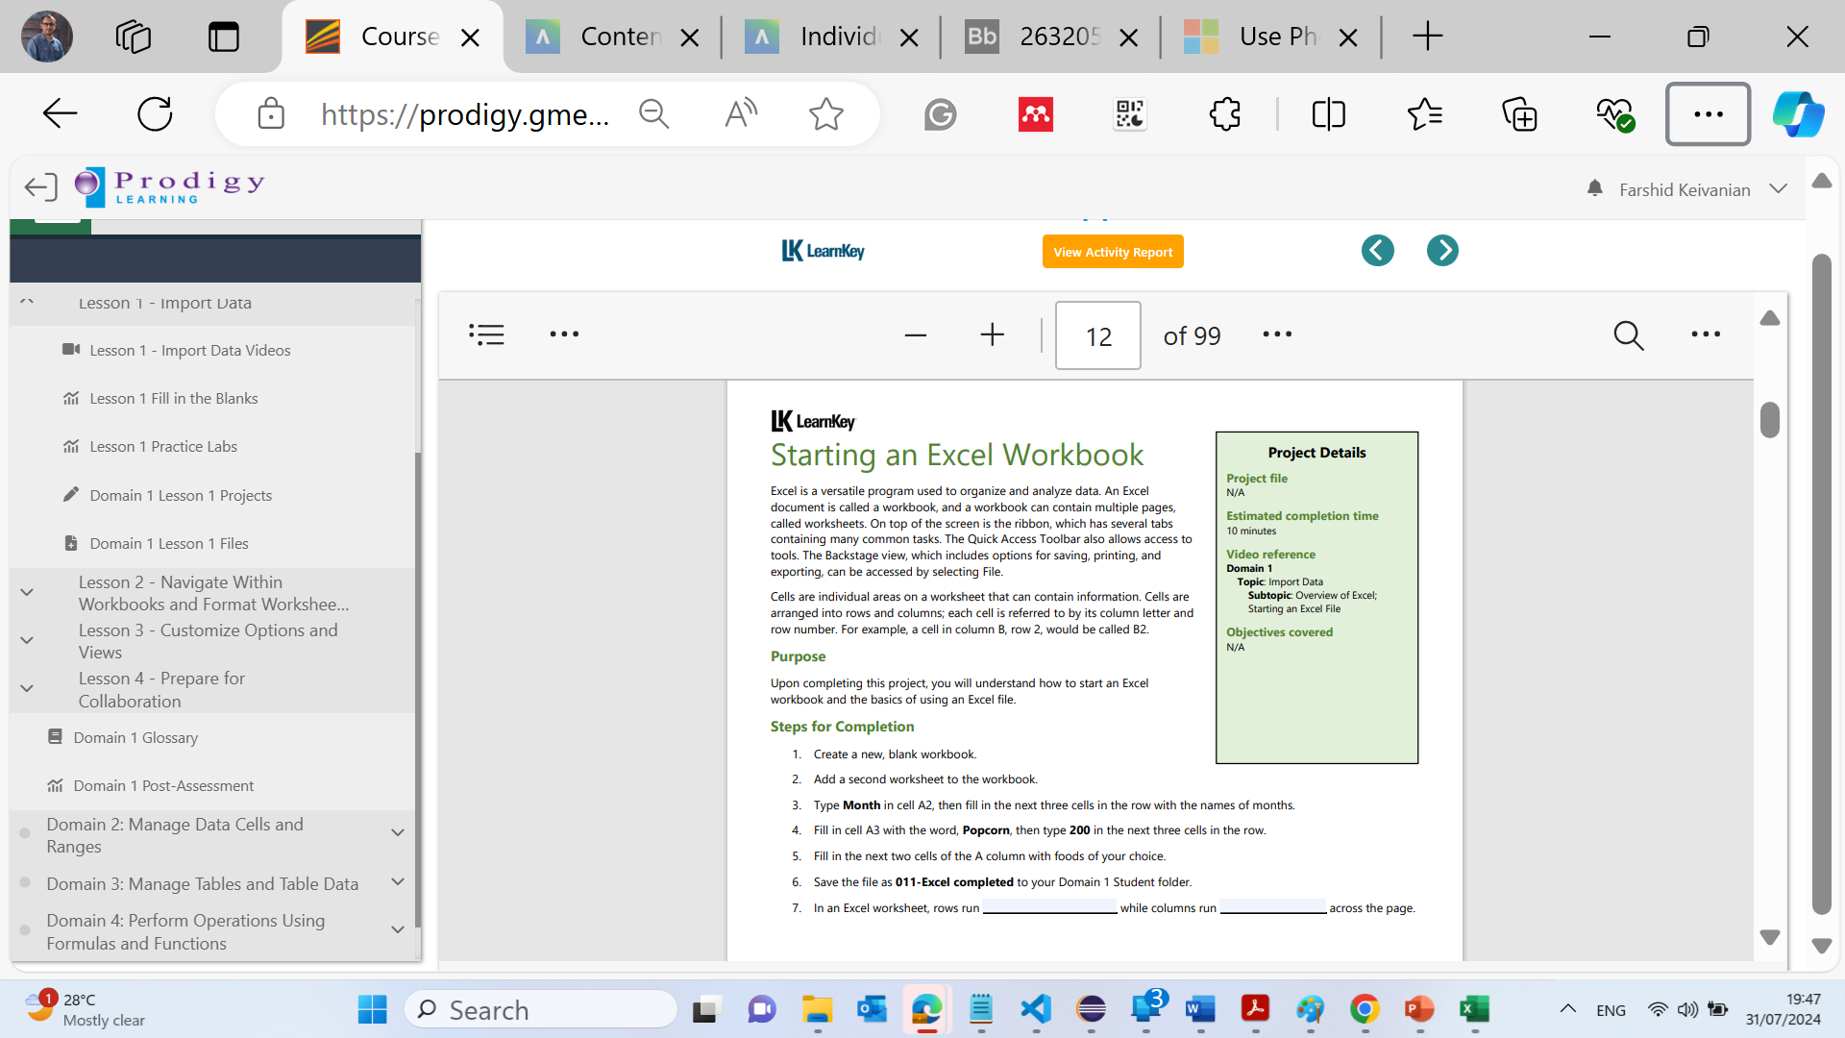
Domain 1 >> Lesson 1 – Starting an Excel

Slide 18
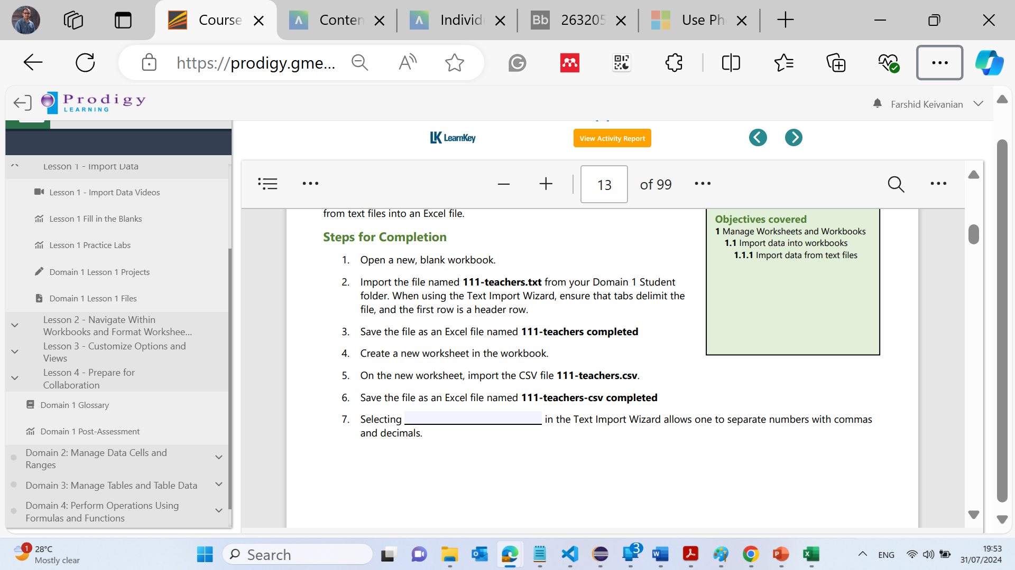
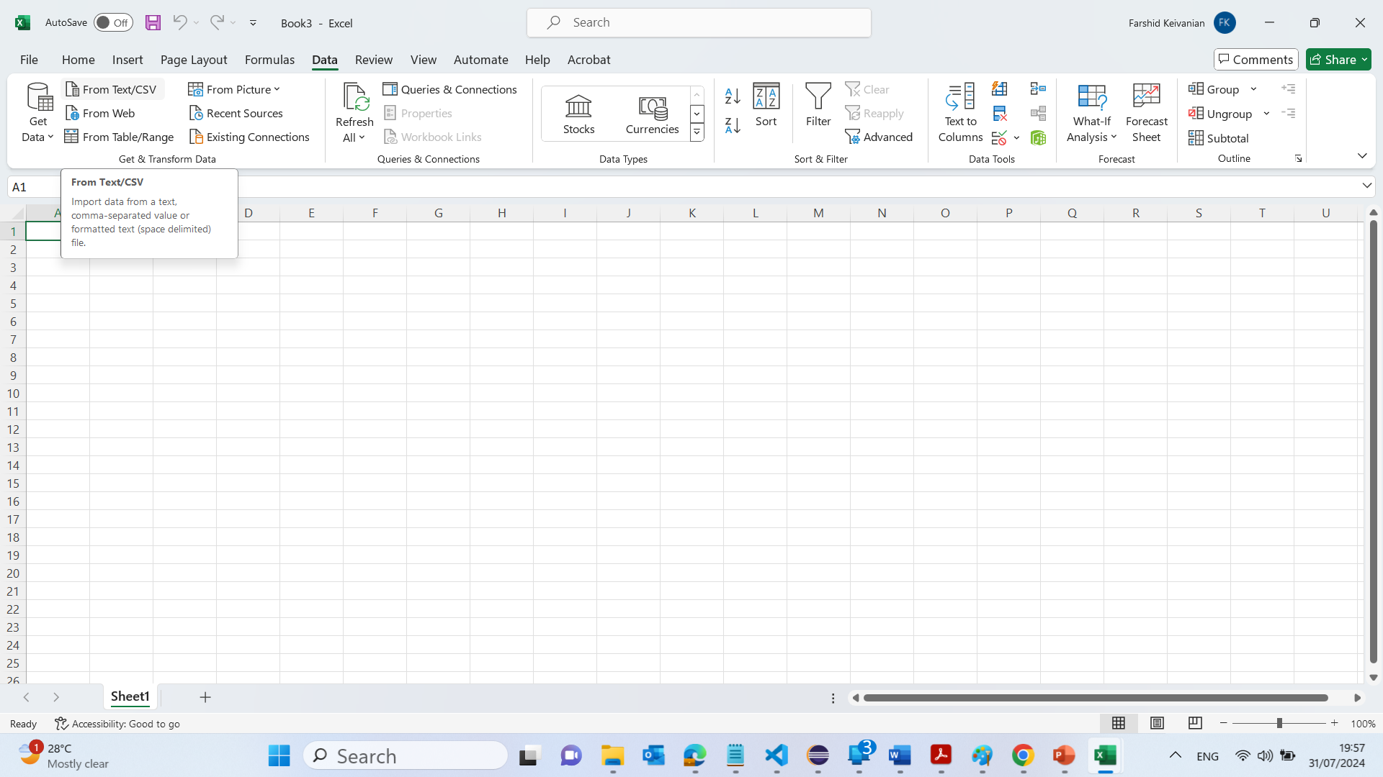
Domain 1 >> Lesson 1 – Import Data From Text Files
Steps for Completion
Open a new, blank workbook.
If Excel did not open with a blank workbook, you can create one by going to File > New > Blank Workbook
Import the file named 111-teachers.txt from your Domain 1 Student folder. When using the Text Import Wizard, ensure that tabs delimit the file, and the first row is a header row.
How to do:
Go to the Data tab on the Ribbon.
Click on From Text/CSV.
Browse and select the 111-teachers.txt file from your Domain 1 Student folder.
Press Tab and Click on Load

Slide 19
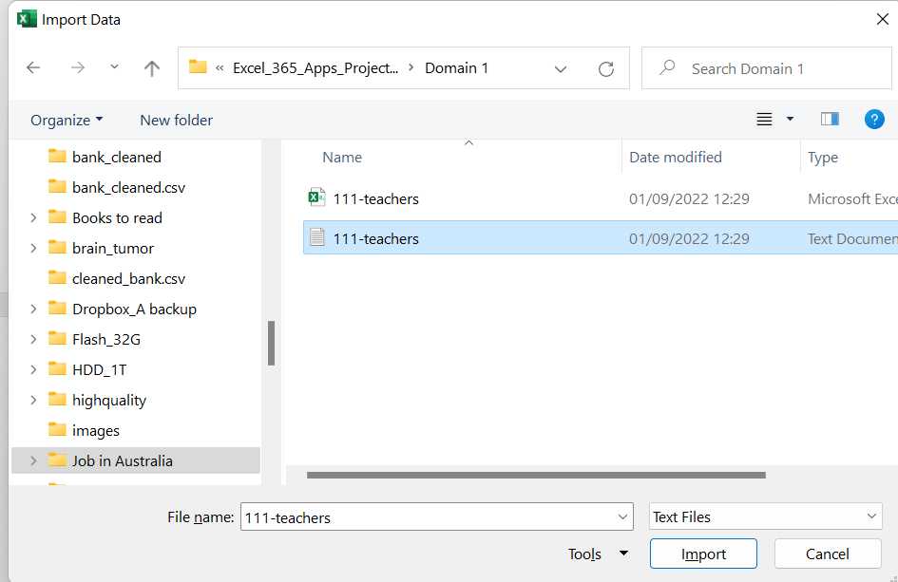
Domain 1 >> Lesson 1 – Import Data From Text Files
Steps for Completion
Open a new, blank workbook.
If Excel did not open with a blank workbook, you can create one by going to File > New > Blank Workbook
Import the file named 111-teachers.txt from your Domain 1 Student folder. When using the Text Import Wizard, ensure that tabs delimit the file, and the first row is a header row.
How to do:
Go to the Data tab on the Ribbon.
Click on From Text/CSV.
Browse and select the 111-teachers.txt file from your Domain 1 Student folder.
Press Tab and Click on Load

Slide 20
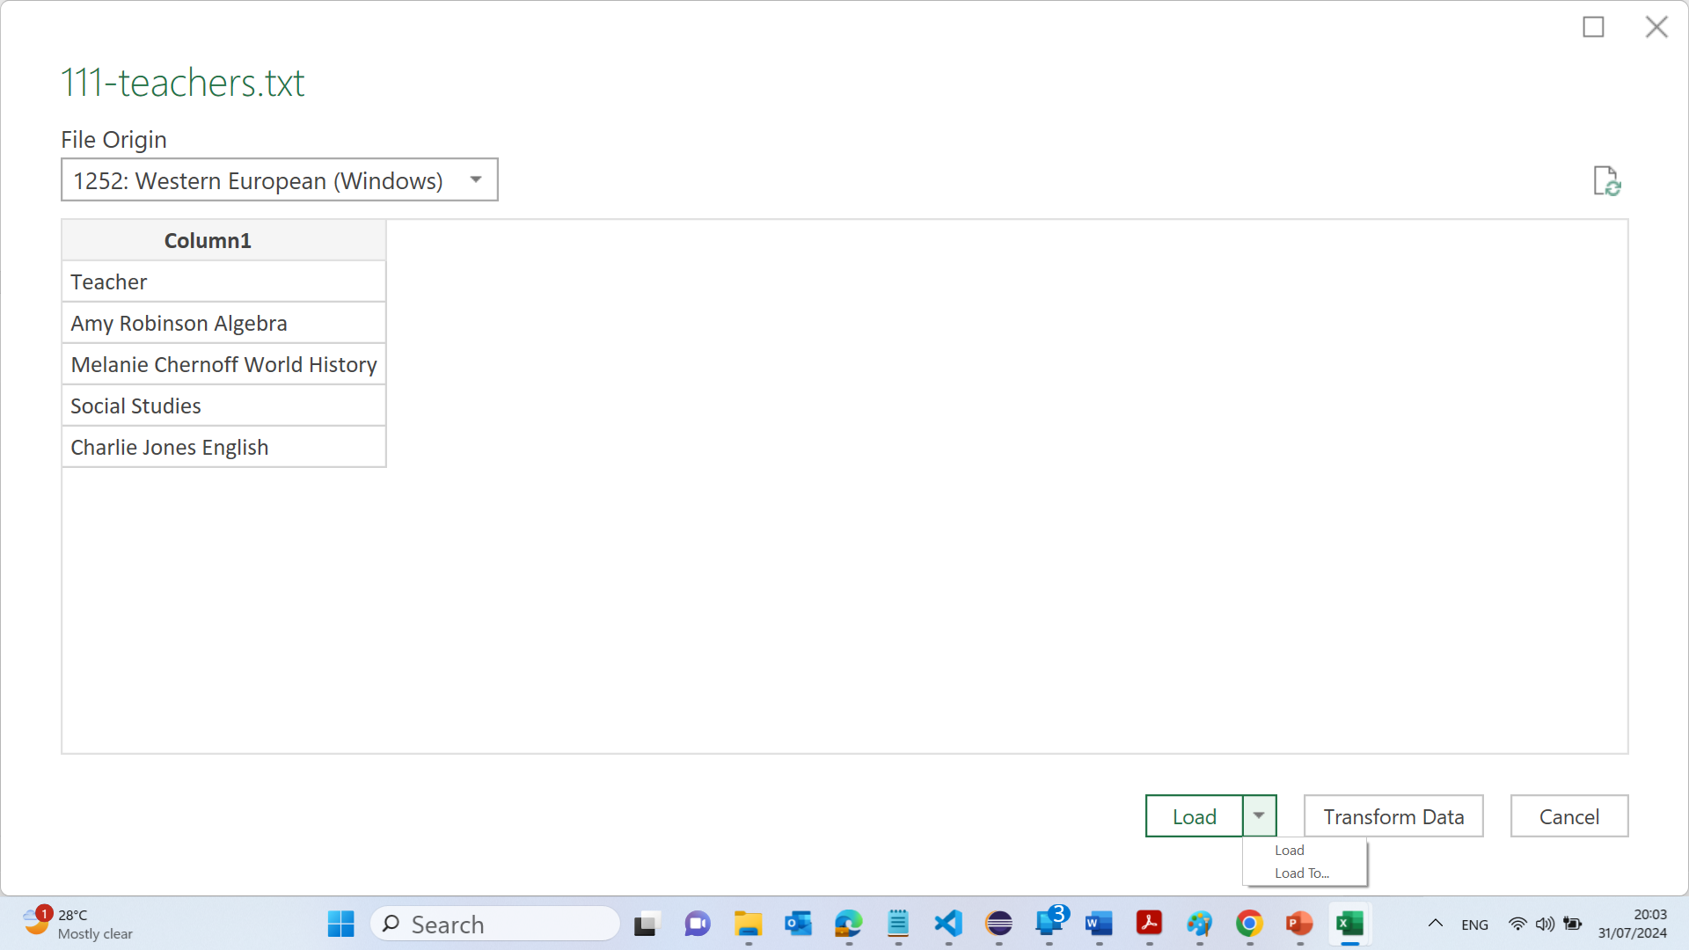
Domain 1 >> Lesson 1 – Import Data From Text Files
Steps for Completion
Open a new, blank workbook.
If Excel did not open with a blank workbook, you can create one by going to File > New > Blank Workbook
Import the file named 111-teachers.txt from your Domain 1 Student folder. When using the Text Import Wizard, ensure that tabs delimit the file, and the first row is a header row.
How to do:
Go to the Data tab on the Ribbon.
Click on From Text/CSV.
Browse and select the 111-teachers.txt file from your Domain 1 Student folder.
Press Tab and Click on Load

Slide 21
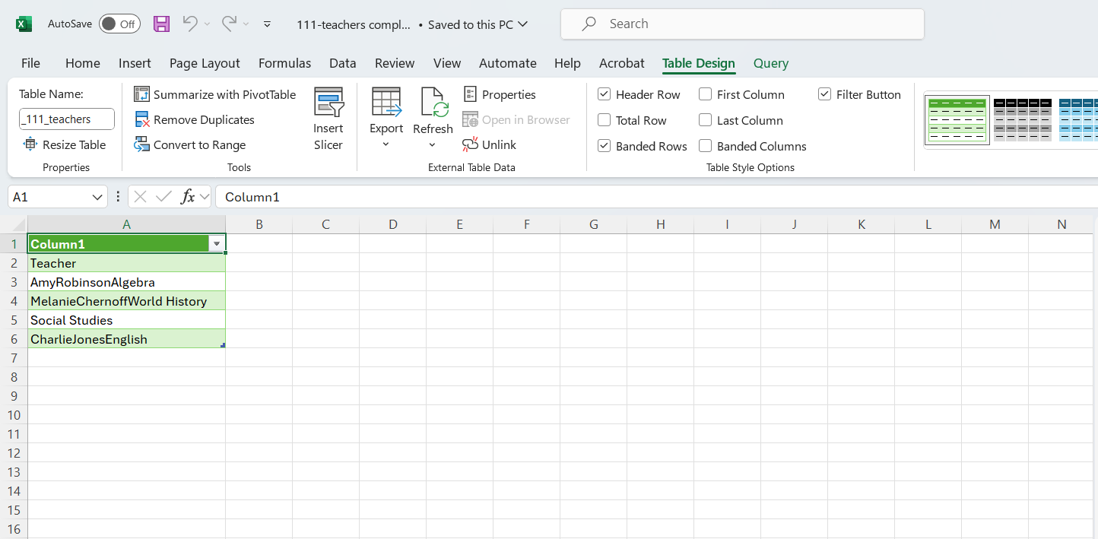
Domain 1 >> Lesson 1 – Import Data From Text Files
3. Save the file as an Excel file named 111-teachers completed.
How to do: Click on File > Save As, then choose a location to save the file. Enter the file name 111-teachers completed and ensure the file type is set to Excel Workbook (*.xlsx).

Slide 22
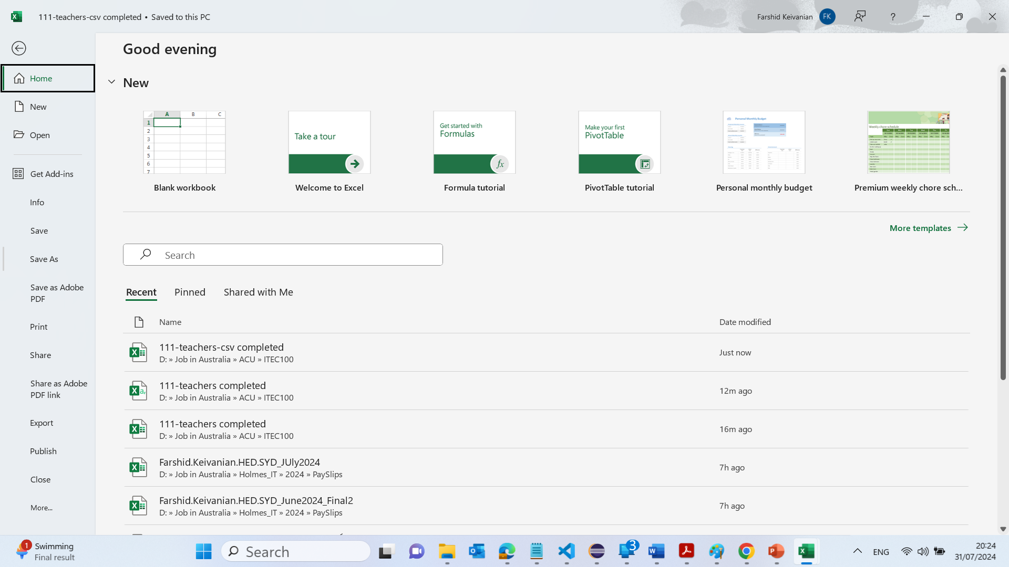
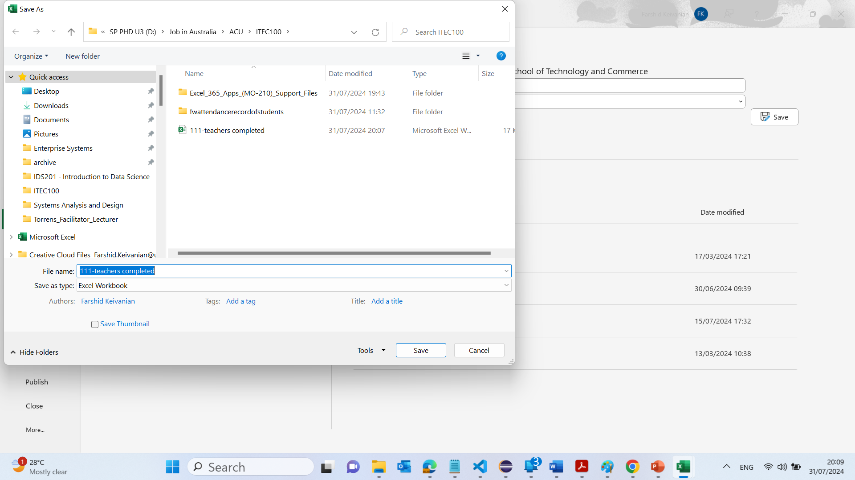
Domain 1 >> Lesson 1 – Import Data From Text Files
3. Save the file as an Excel file named 111-teachers completed.
How to do: Click on File > Save As, then choose a location to save the file. Enter the file name 111-teachers completed and ensure the file type is set to Excel Workbook (*.xlsx).

Slide 23
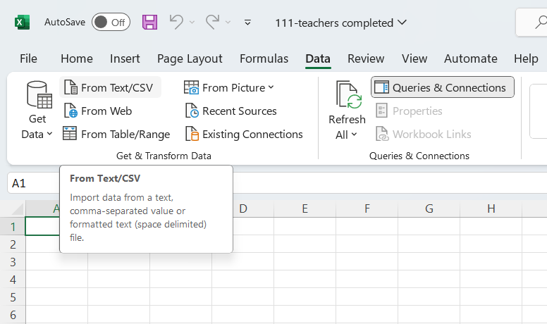
Domain 1 >> Lesson 1 – Import Data From Text Files
4. Create a new worksheet in the workbook.
How to do: Click the + button at the bottom left of the Excel window to add a new sheet.
On the new worksheet, import the CSV file 111-teachers.csv.
How to do:
Click on the new sheet tab to select it.
Go to the Data tab on the Ribbon.
Click on From Text/CSV.
Browse and select the 111-teachers.csv file.
Follow the import steps, making sure to set the appropriate delimiters and confirm the data has headers.
Save the file as an Excel file named 111-teachers-csv completed.
How to do: Click on File > Save As, then choose a location to save the file. Enter the file name 111-teachers-csv completed and ensure the file type is set to Excel Workbook (*.xlsx).

Slide 24
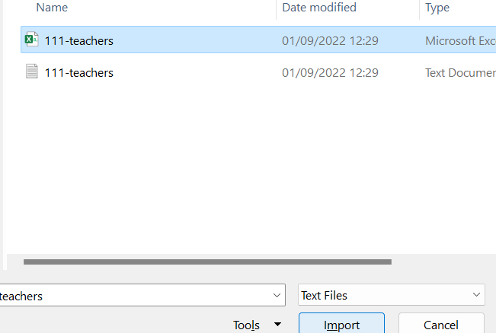
Domain 1 >> Lesson 1 – Import Data From Text Files
4. Create a new worksheet in the workbook.
How to do: Click the + button at the bottom left of the Excel window to add a new sheet.
On the new worksheet, import the CSV file 111-teachers.csv.
How to do:
Click on the new sheet tab to select it.
Go to the Data tab on the Ribbon.
Click on From Text/CSV.
Browse and select the 111-teachers.csv file.
Follow the import steps, making sure to set the appropriate delimiters and confirm the data has headers.
Save the file as an Excel file named 111-teachers-csv completed.
How to do: Click on File > Save As, then choose a location to save the file. Enter the file name 111-teachers-csv completed and ensure the file type is set to Excel Workbook (*.xlsx).

Slide 25
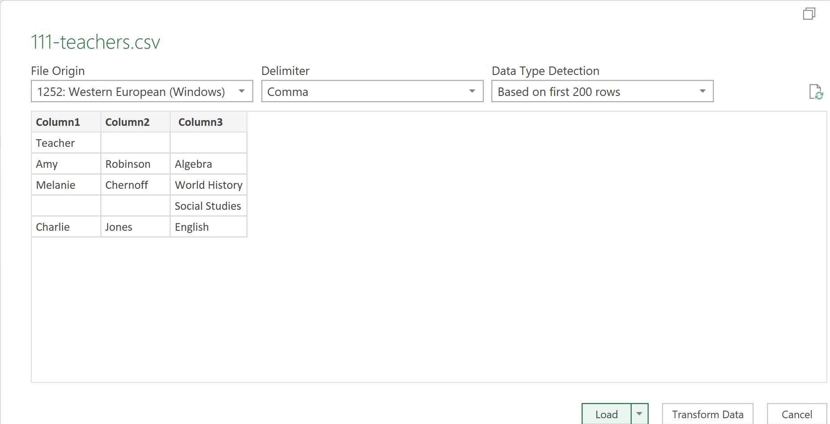
Domain 1 >> Lesson 1 – Import Data From Text Files
4. Create a new worksheet in the workbook.
How to do: Click the + button at the bottom left of the Excel window to add a new sheet.
On the new worksheet, import the CSV file 111-teachers.csv.
How to do:
Click on the new sheet tab to select it.
Go to the Data tab on the Ribbon.
Click on From Text/CSV.
Browse and select the 111-teachers.csv file.
Follow the import steps, making sure to set the appropriate delimiters and confirm the data has headers.
Save the file as an Excel file named 111-teachers-csv completed.
How to do: Click on File > Save As, then choose a location to save the file. Enter the file name 111-teachers-csv completed and ensure the file type is set to Excel Workbook (*.xlsx).

Slide 26
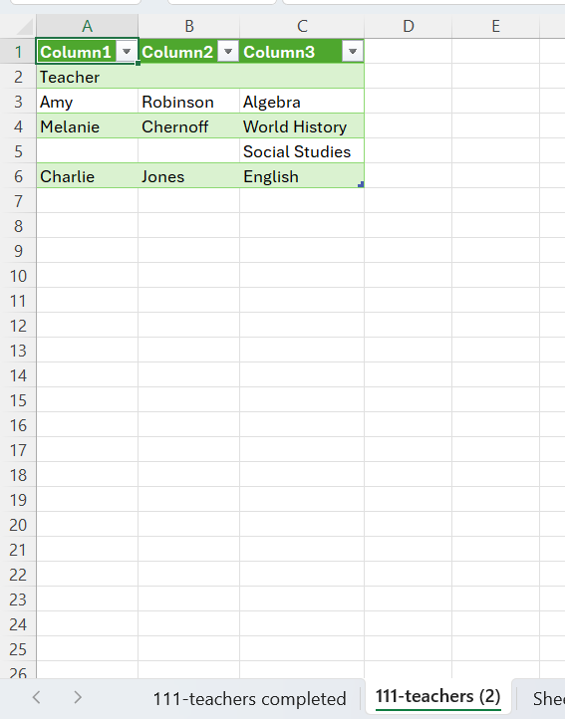
Domain 1 >> Lesson 1 – Import Data From Text Files
4. Create a new worksheet in the workbook.
How to do: Click the + button at the bottom left of the Excel window to add a new sheet.
On the new worksheet, import the CSV file 111-teachers.csv.
How to do:
Click on the new sheet tab to select it.
Go to the Data tab on the Ribbon.
Click on From Text/CSV.
Browse and select the 111-teachers.csv file.
Follow the import steps, making sure to set the appropriate delimiters and confirm the data has headers.
Save the file as an Excel file named 111-teachers-csv completed.
How to do: Click on File > Save As, then choose a location to save the file. Enter the file name 111-teachers-csv completed and ensure the file type is set to Excel Workbook (*.xlsx).

Slide 27
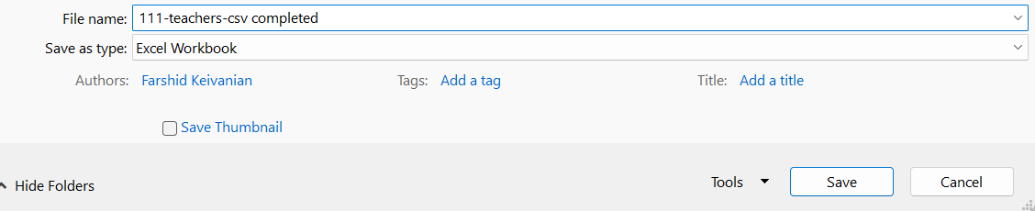
Domain 1 >> Lesson 1 – Import Data From Text Files
4. Create a new worksheet in the workbook.
How to do: Click the + button at the bottom left of the Excel window to add a new sheet.
On the new worksheet, import the CSV file 111-teachers.csv.
How to do:
Click on the new sheet tab to select it.
Go to the Data tab on the Ribbon.
Click on From Text/CSV.
Browse and select the 111-teachers.csv file.
Follow the import steps, making sure to set the appropriate delimiters and confirm the data has headers.
Save the file as an Excel file named 111-teachers-csv completed.
How to do: Click on File > Save As, then choose a location to save the file. Enter the file name 111-teachers-csv completed and ensure the file type is set to Excel Workbook (*.xlsx).

Slide 28
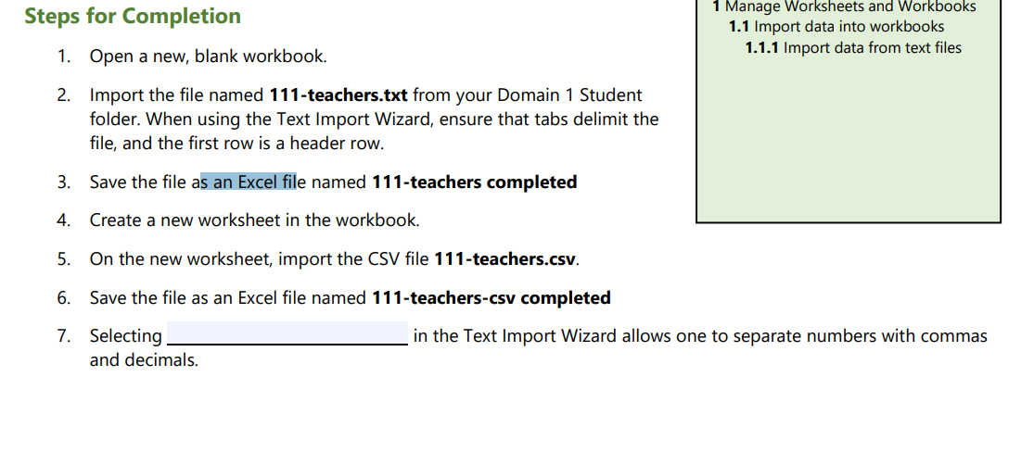
Domain 1 >> Lesson 1 – Import Data From Text Files
4. Create a new worksheet in the workbook.
How to do: Click the + button at the bottom left of the Excel window to add a new sheet.
On the new worksheet, import the CSV file 111-teachers.csv.
How to do:
Click on the new sheet tab to select it.
Go to the Data tab on the Ribbon.
Click on From Text/CSV.
Browse and select the 111-teachers.csv file.
Follow the import steps, making sure to set the appropriate delimiters and confirm the data has headers.
Save the file as an Excel file named 111-teachers-csv completed.
How to do: Click on File > Save As, then choose a location to save the file. Enter the file name 111-teachers-csv completed and ensure the file type is set to Excel Workbook (*.xlsx).
In the Text Import Wizard, there is an option to specify the character set and delimiters. The missing part likely refers to choosing the correct delimiter. Usually, you would select the Comma delimiter to separate numbers properly. Ensure the appropriate decimal separator is chosen (dot or comma) depending on your regional settings.

Slide 29
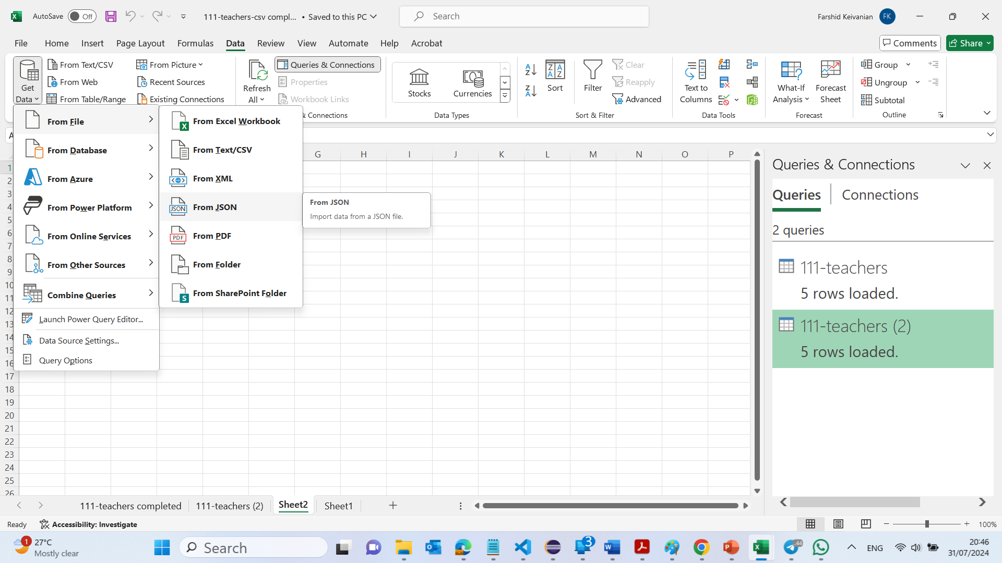
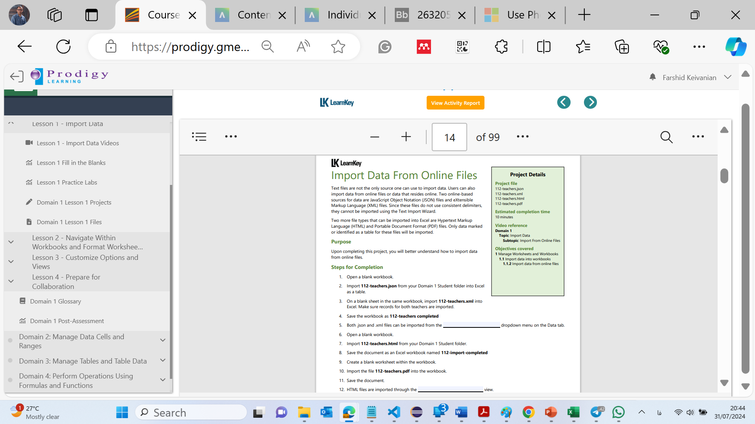
Domain 1 >> Lesson 1 – Import Data From Online Files

Slide 30
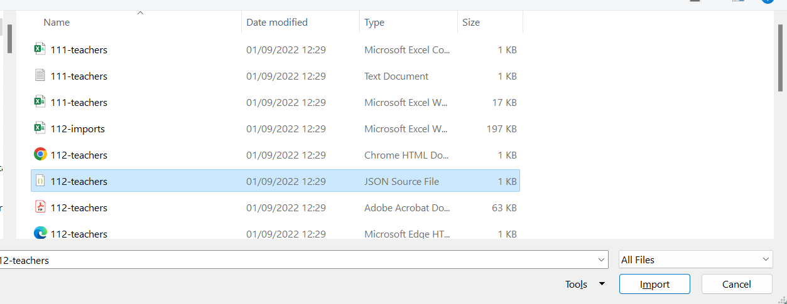
Domain 1 >> Lesson 1 – Import Data From Online Files
Steps 1 to 4:
Open a blank workbook:
Open Excel. If it doesn't open with a blank workbook, create one by going to File > New > Blank Workbook.
Import 112-teachers.json:
Go to the Data tab on the Ribbon.
Click on Get Data > From File > From JSON.
Browse and select the 112-teachers.json file from your Domain 1 Student folder.
Import the data as a table.

Slide 31
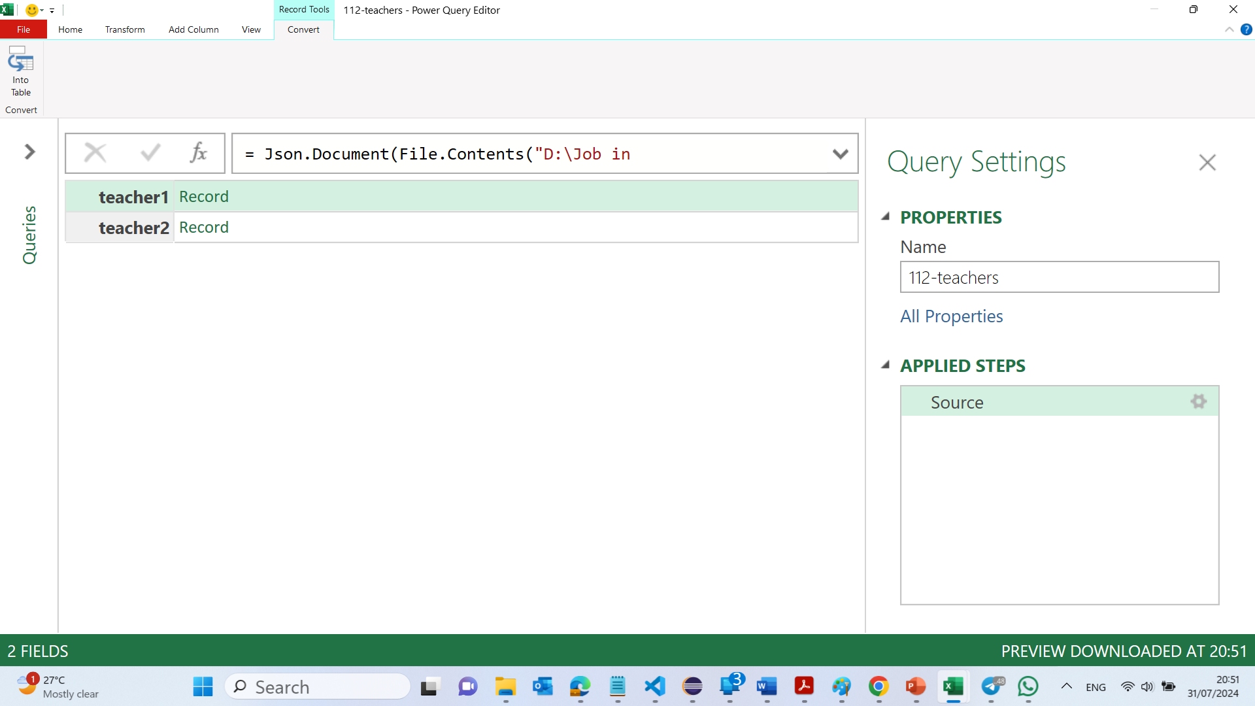
Domain 1 >> Lesson 1 – Import Data From Online Files
Steps 1 to 4:
Open a blank workbook:
Open Excel. If it doesn't open with a blank workbook, create one by going to File > New > Blank Workbook.
Import 112-teachers.json:
Go to the Data tab on the Ribbon.
Click on Get Data > From File > From JSON.
Browse and select the 112-teachers.json file from your Domain 1 Student folder.
Import the data as a table.

Slide 32
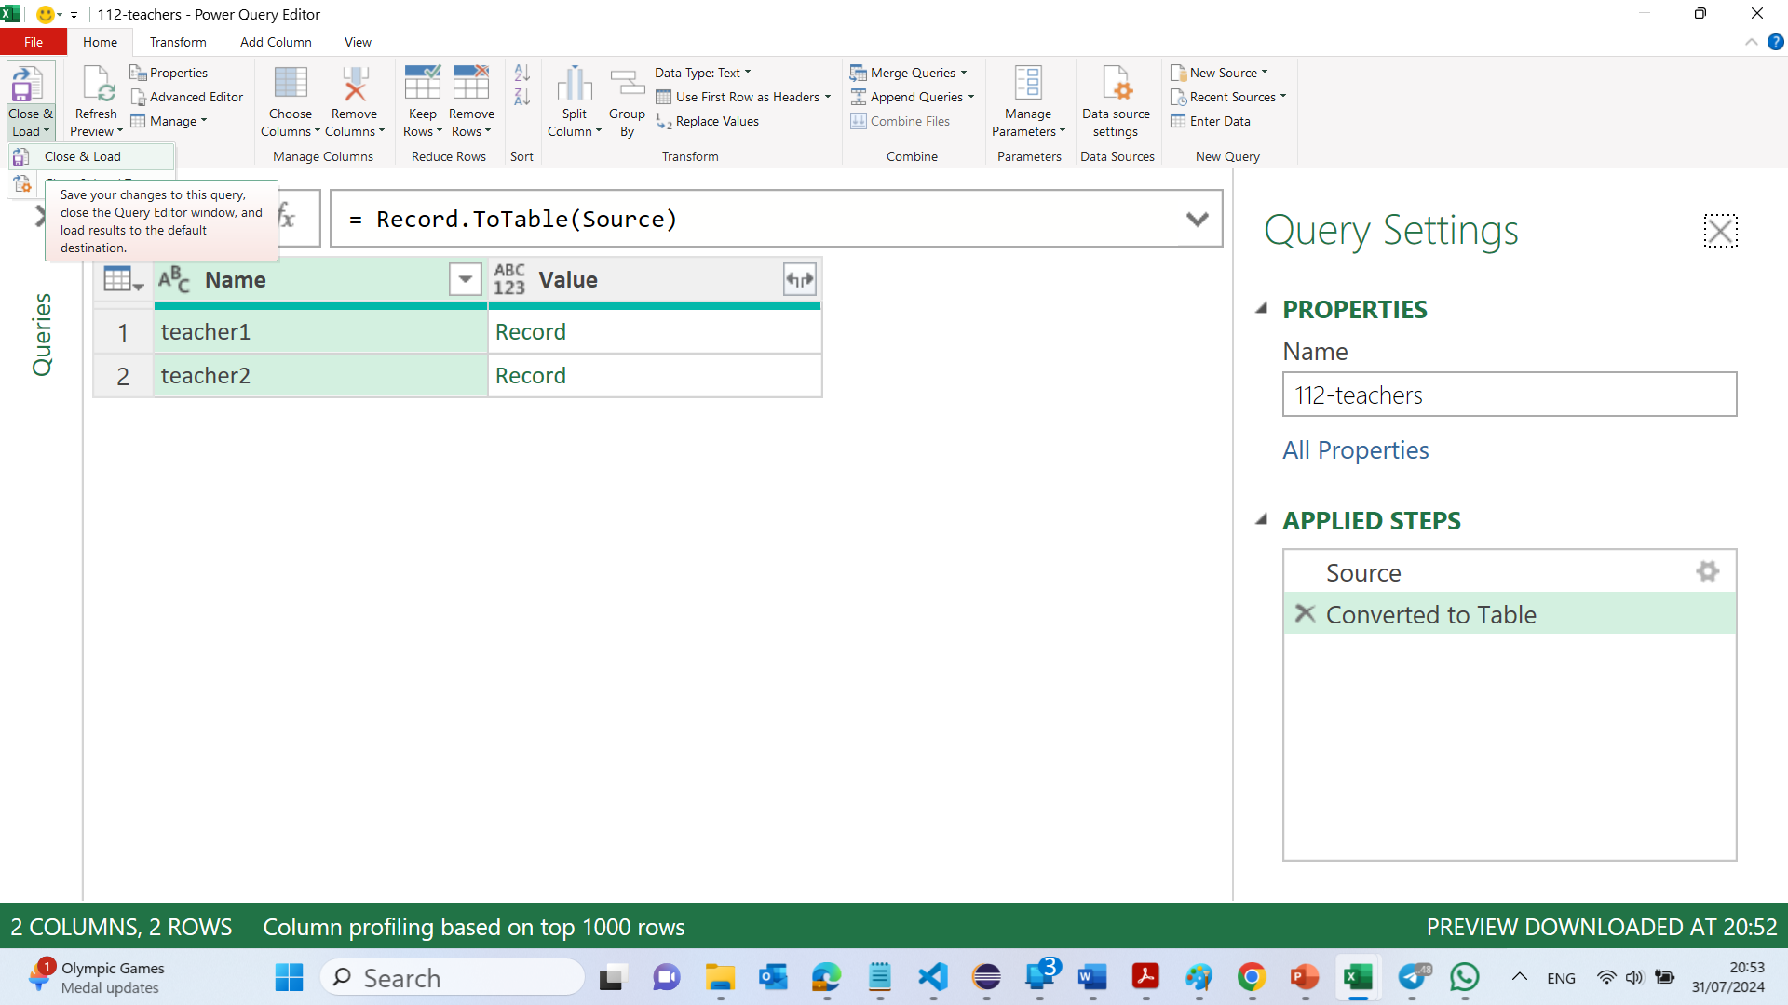
Domain 1 >> Lesson 1 – Import Data From Online Files
Steps 1 to 4:
Open a blank workbook:
Open Excel. If it doesn't open with a blank workbook, create one by going to File > New > Blank Workbook.
Import 112-teachers.json:
Go to the Data tab on the Ribbon.
Click on Get Data > From File > From JSON.
Browse and select the 112-teachers.json file from your Domain 1 Student folder.
Import the data as a table.

Slide 33
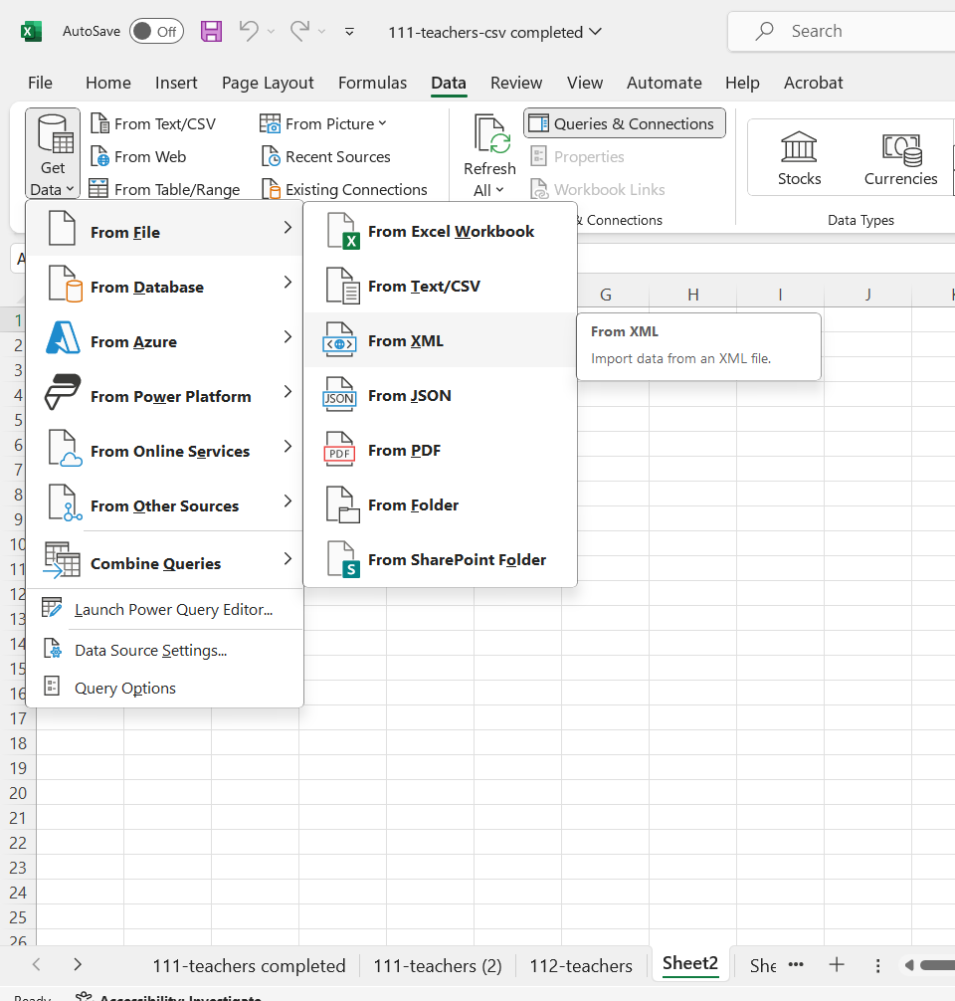
Domain 1 >> Lesson 1 – Import Data From Online Files
Import 112-teachers.xml:
Open a blank sheet in the same workbook by clicking the + button at the bottom to add a new worksheet.
Go to the Data tab on the Ribbon.
Click on Get Data > From File > From XML.
Browse and select the 112-teachers.xml file from your Domain 1 Student folder.
Ensure all records for both teachers are imported.
Save the workbook:
Save the workbook by going to File > Save As.
Name the file 112-teachers-completed.

Slide 34
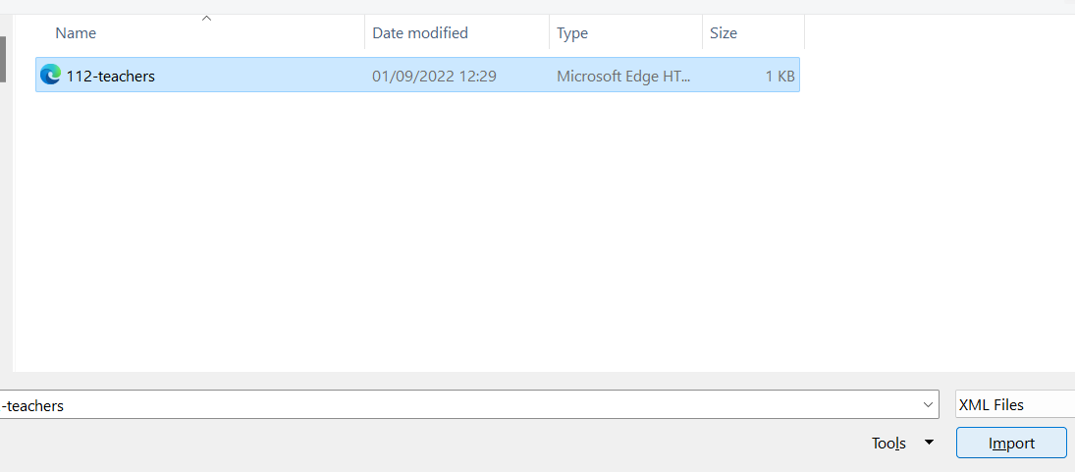
Domain 1 >> Lesson 1 – Import Data From Online Files
Import 112-teachers.xml:
Open a blank sheet in the same workbook by clicking the + button at the bottom to add a new worksheet.
Go to the Data tab on the Ribbon.
Click on Get Data > From File > From XML.
Browse and select the 112-teachers.xml file from your Domain 1 Student folder.
Ensure all records for both teachers are imported.
Save the workbook:
Save the workbook by going to File > Save As.
Name the file 112-teachers-completed.

Slide 35
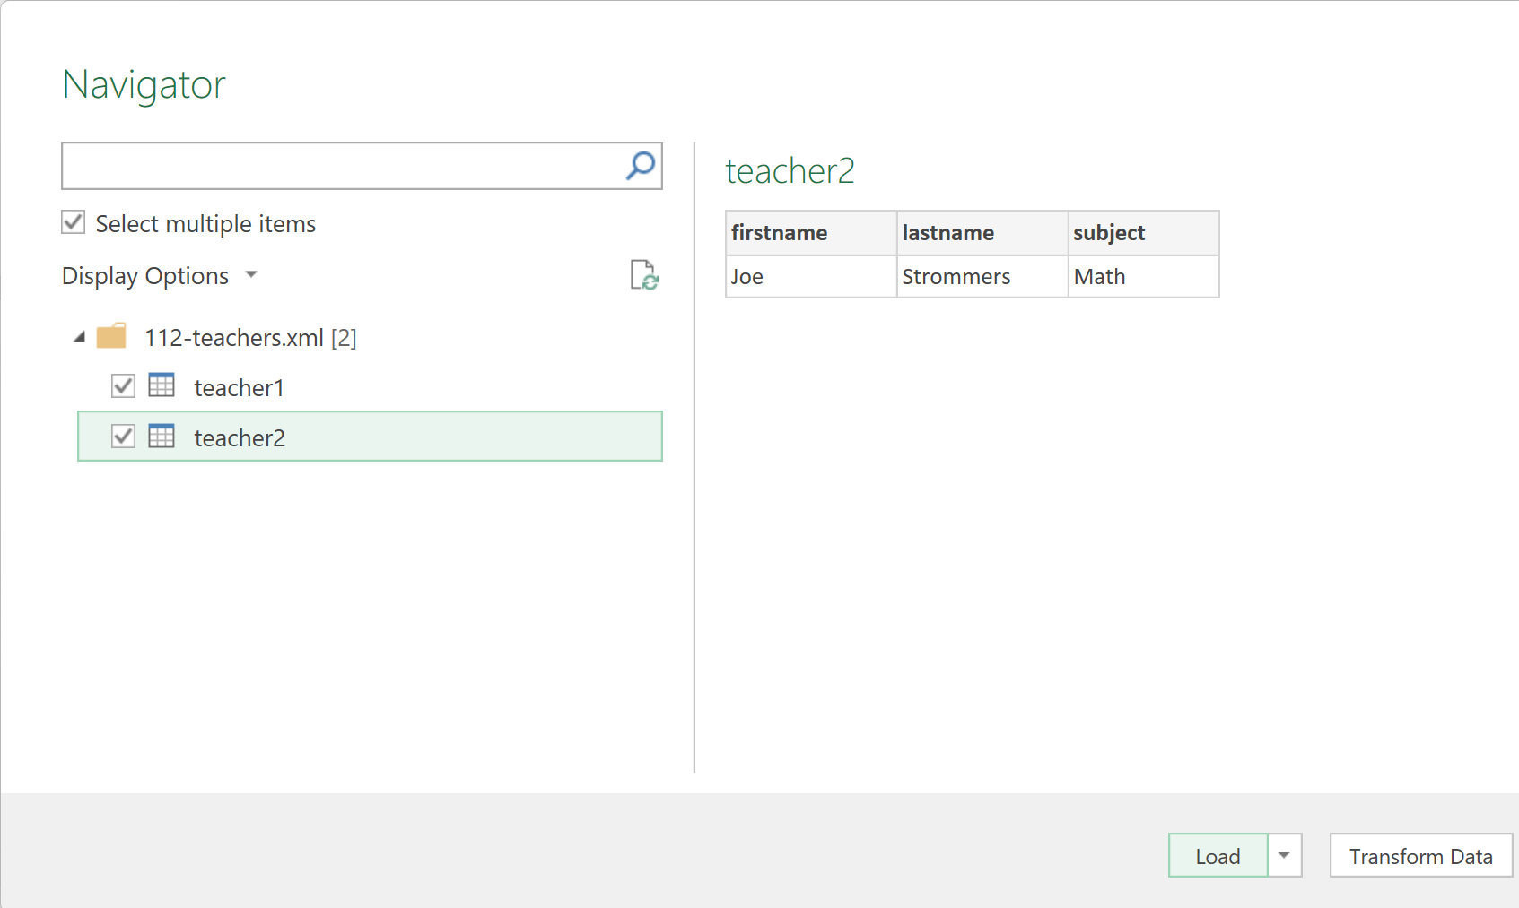
Domain 1 >> Lesson 1 – Import Data From Online Files
Import 112-teachers.xml:
Open a blank sheet in the same workbook by clicking the + button at the bottom to add a new worksheet.
Go to the Data tab on the Ribbon.
Click on Get Data > From File > From XML.
Browse and select the 112-teachers.xml file from your Domain 1 Student folder.
Ensure all records for both teachers are imported.
Save the workbook:
Save the workbook by going to File > Save As.
Name the file 112-teachers-completed.

Slide 36
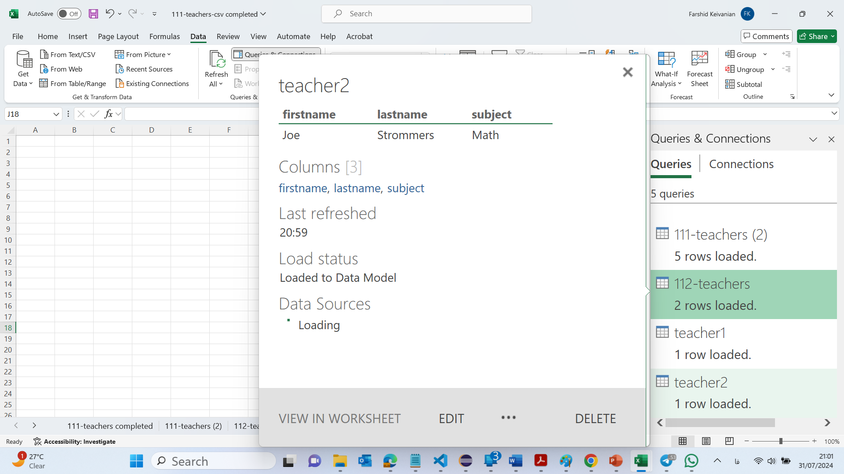
Domain 1 >> Lesson 1 – Import Data From Online Files
Import 112-teachers.xml:
Open a blank sheet in the same workbook by clicking the + button at the bottom to add a new worksheet.
Go to the Data tab on the Ribbon.
Click on Get Data > From File > From XML.
Browse and select the 112-teachers.xml file from your Domain 1 Student folder.
Ensure all records for both teachers are imported.
Save the workbook:
Save the workbook by going to File > Save As.
Name the file 112-teachers-completed.

Slide 37
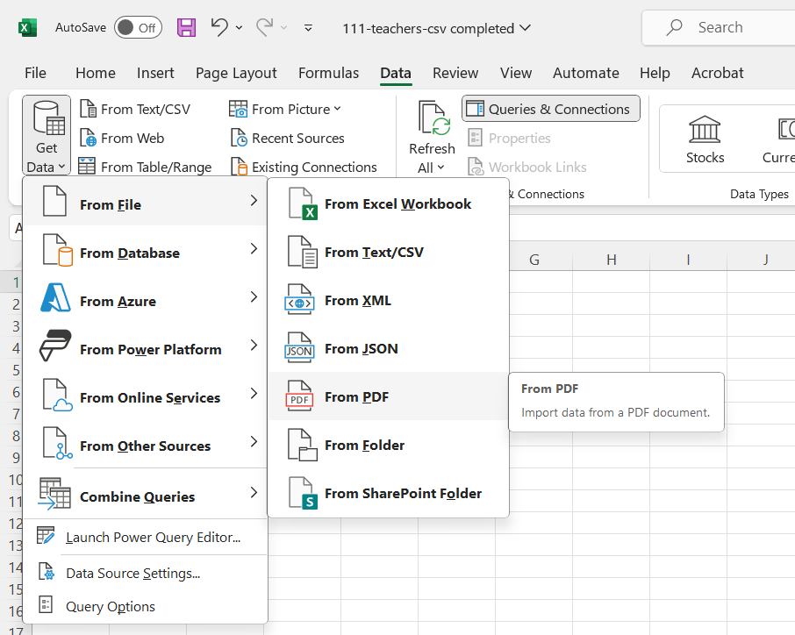
Domain 1 >> Lesson 1 – Import Data From PDF Files
Create a blank worksheet:
Click the + button at the bottom to add a new worksheet.
Import 112-teachers.pdf:
Go to the Data tab on the Ribbon.
Click on Get Data > From File > From PDF.
Browse and select the 112-teachers.pdf file from your Domain 1 Student folder.
Follow the prompts to import the data.
Save the document:
Save the document again to ensure all imports are saved properly.

Slide 38
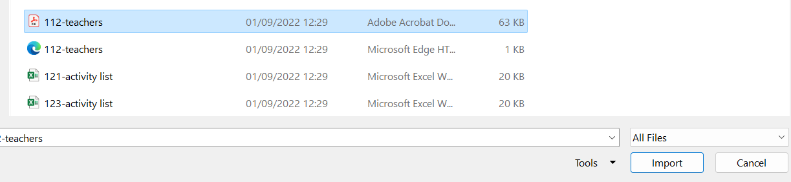
Domain 1 >> Lesson 1 – Import Data From PDF Files
Create a blank worksheet:
Click the + button at the bottom to add a new worksheet.
Import 112-teachers.pdf:
Go to the Data tab on the Ribbon.
Click on Get Data > From File > From PDF.
Browse and select the 112-teachers.pdf file from your Domain 1 Student folder.
Follow the prompts to import the data.
Save the document:
Save the document again to ensure all imports are saved properly.

Slide 39
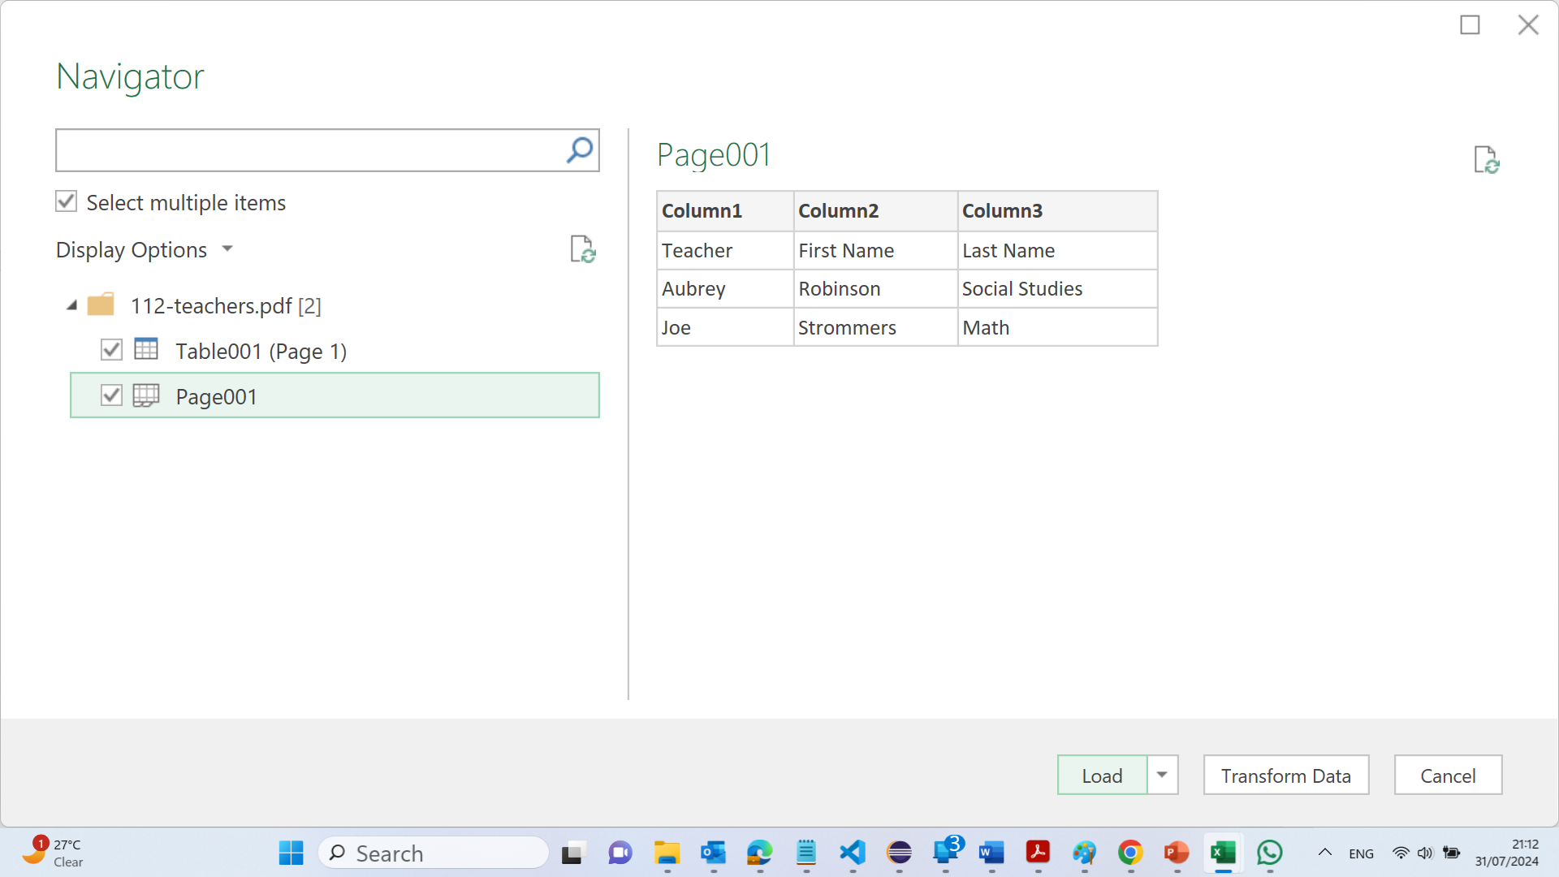
Domain 1 >> Lesson 1 – Import Data From PDF Files
Create a blank worksheet:
Click the + button at the bottom to add a new worksheet.
Import 112-teachers.pdf:
Go to the Data tab on the Ribbon.
Click on Get Data > From File > From PDF.
Browse and select the 112-teachers.pdf file from your Domain 1 Student folder.
Follow the prompts to import the data.
Save the document:
Save the document again to ensure all imports are saved properly.
For HTML imports, you might use Get Data > From File > From Web, and then enter the file path.
For PDF imports, make sure you have the latest version of Excel, as older versions may not support direct PDF imports.

Slide 40
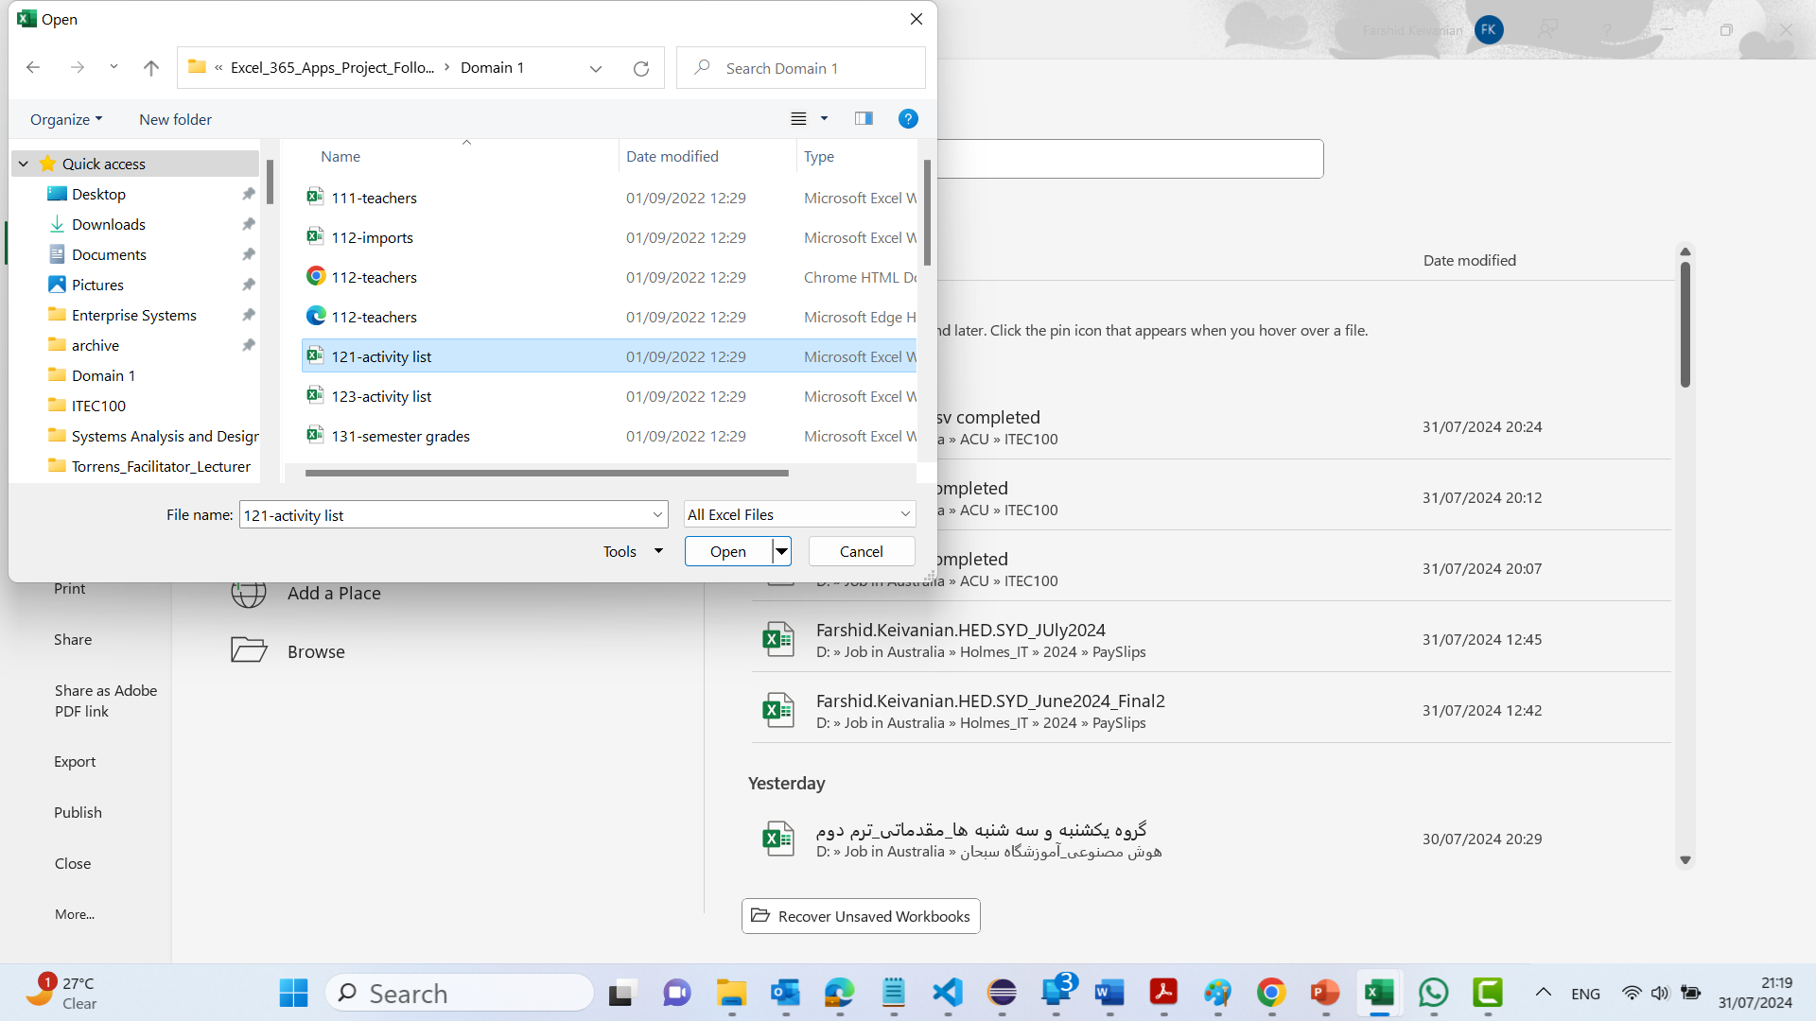
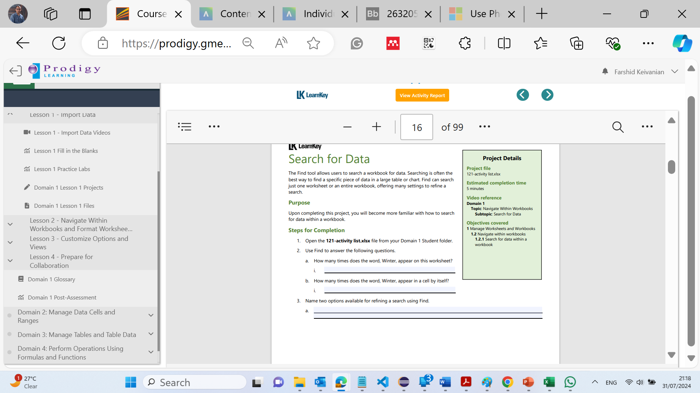
Domain 1 >> Lesson 2 – Search for Data

Slide 41
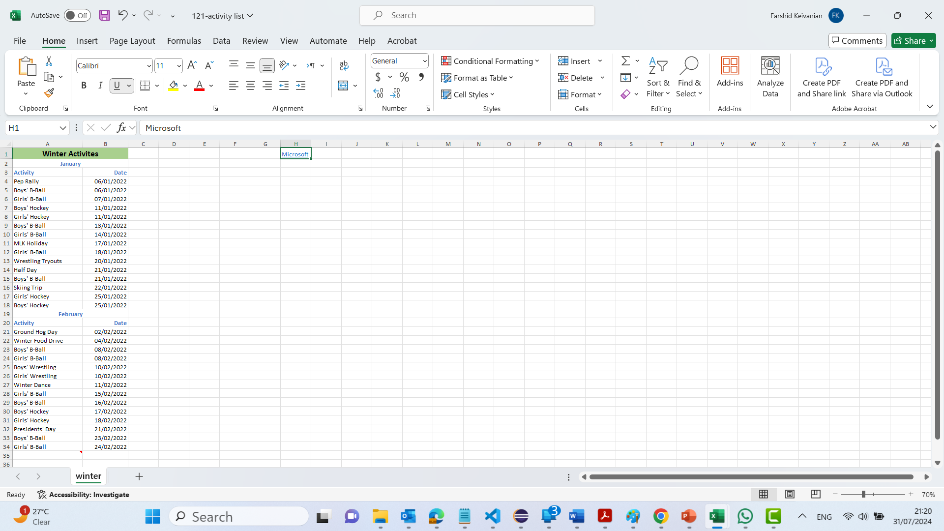
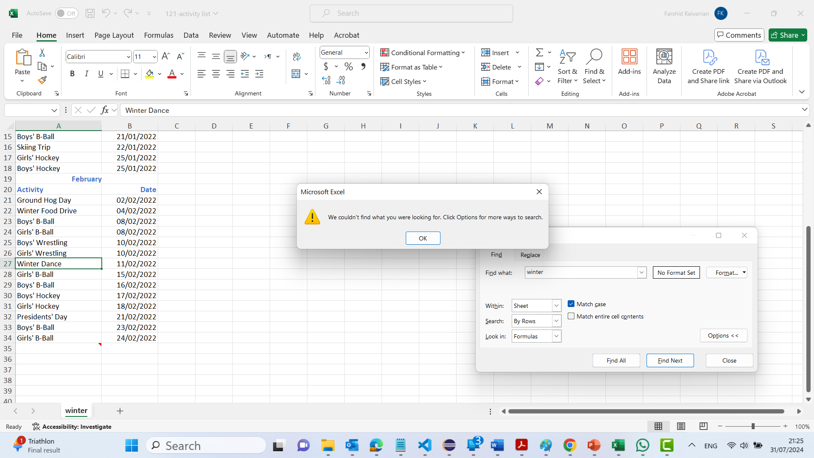
Domain 1 >> Lesson 2 – Search for Data
If we select ‘Match case’, then the search will become case sensitive.
Name two options available for refining a search using Find.
You can refine a search using Find in Excel by:
Checking the option to match the entire cell contents.
Specifying the search to match the case (case-sensitive search)

Slide 42
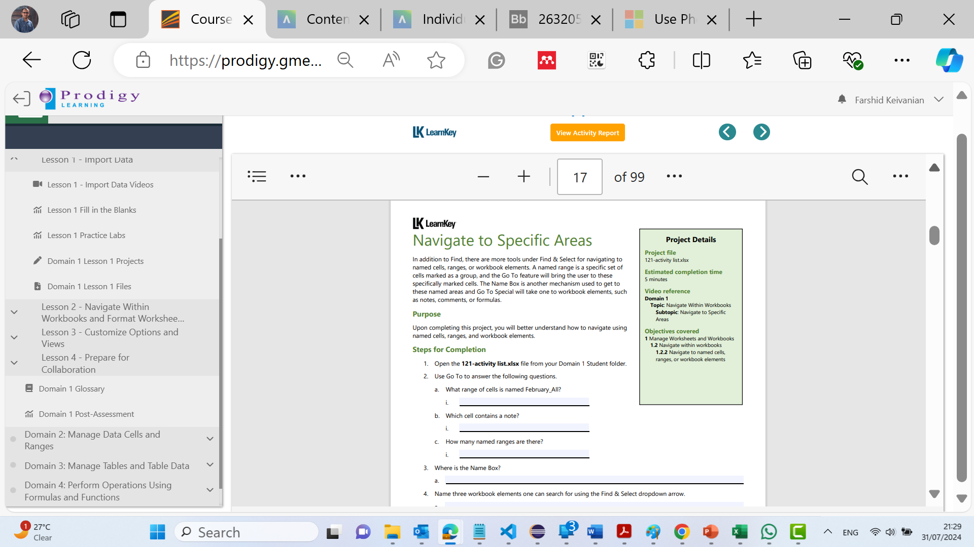
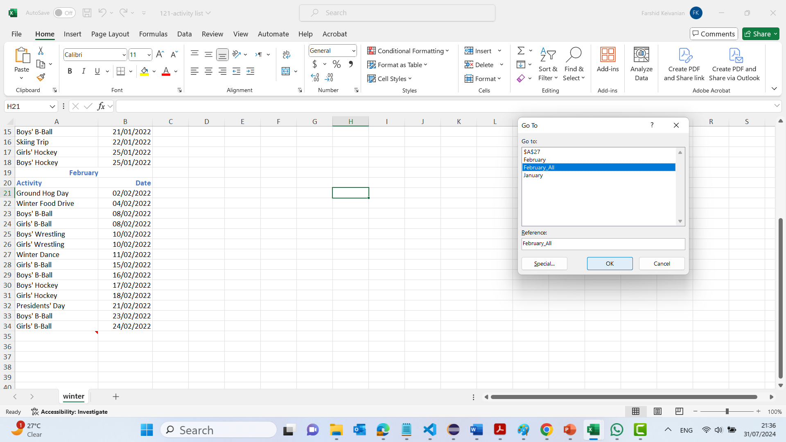
Domain 1 >> Lesson 2 – Navigate to Specific Areas
Use Go To to answer the following questions.
How to do:
Press Ctrl + G or go to the Home tab, click on February_All and OK.

Slide 43
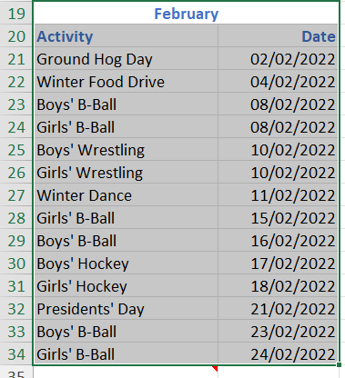
Domain 1 >> Lesson 2 – Navigate to Specific Areas
Use Go To to answer the following questions.
How to do:
Press Ctrl + G or go to the Home tab, click on February_All and OK.

Slide 44
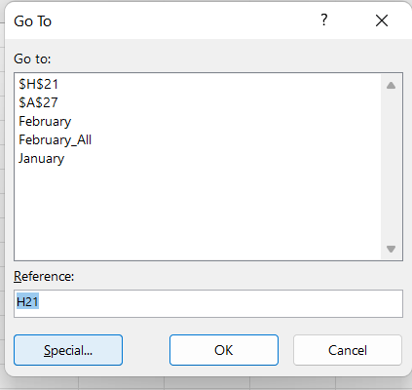
Domain 1 >> Lesson 2 – Navigate to Specific Areas
Which cell contains a note?
How to do:
In the Go To dialog box, click on Special....
Select Notes and click OK.
This will highlight the cell that contains a note.

Slide 45
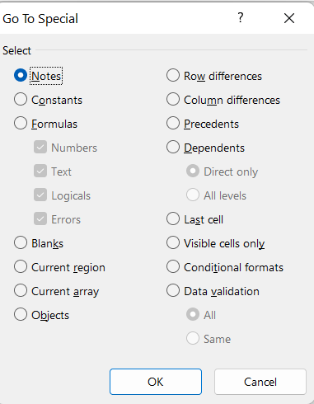
Domain 1 >> Lesson 2 – Navigate to Specific Areas
Which cell contains a note?
How to do:
In the Go To dialog box, click on Special....
Select Notes and click OK.
This will highlight the cell that contains a note.

Slide 46
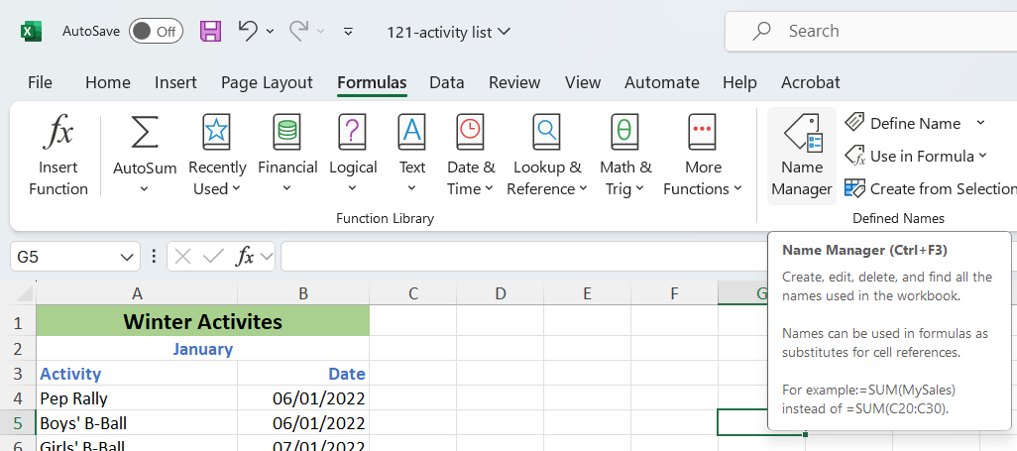
Domain 1 >> Lesson 2 – Navigate to Specific Areas
How many named ranges are there?
How to do:
Click on the Formulas tab.
Click on Name Manager in the Defined Names group.
Count the number of named ranges listed in the Name Manager dialog box.
3

Slide 47
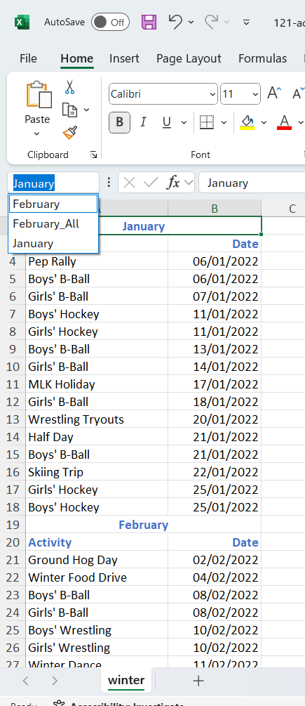
Domain 1 >> Lesson 2 – Navigate to Specific Areas
Where is the Name Box?
How to do:
The Name Box is located to the left of the formula bar at the top of the Excel window. It displays the cell reference or the name of the selected cell or range.

Slide 48
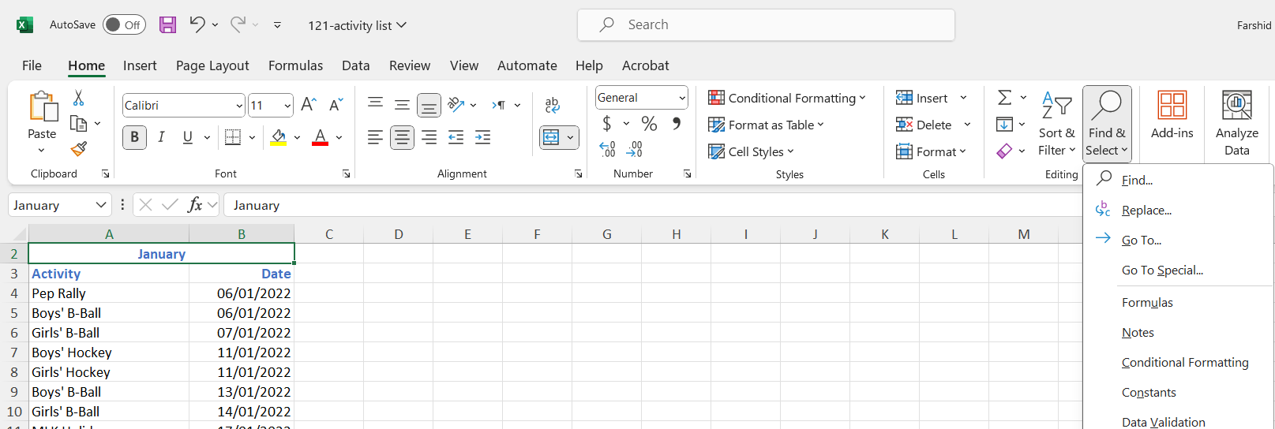
Domain 1 >> Lesson 2 – Navigate to Specific Areas
Name three workbook elements one can search for using the Find & Select dropdown arrow
How to do:
Click on the Home tab.
In the Editing group, click on Find & Select.
From the dropdown list, you can search for:
Formulas
Comments/Notes
Conditional Formatting
Constants
Data Validation

Slide 49
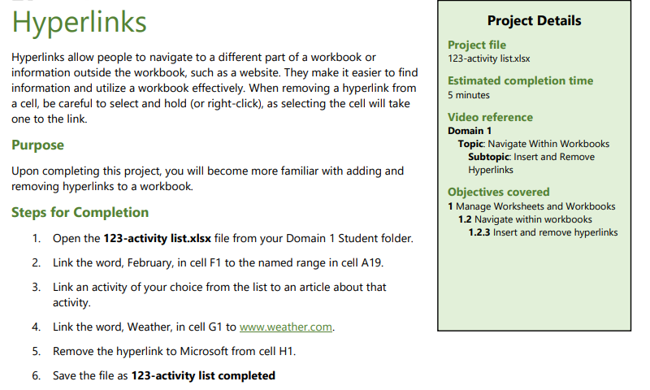
Domain 1 >> Lesson 2 – Hyperlinks

Slide 50

Domain 1 >> Lesson 2 – Hyperlinks
Steps for Completion
Open the File
Instruction: Open the Excel file named 123-activity list.xlsx from your Domain 1 Student folder.
Details: Locate the file on your computer, navigate to your Domain 1 Student folder, and double-click on the file 123-activity list.xlsx to open it in Excel.
Linking a Cell to a Named Range
Instruction: Link the word "February" in cell F1 to the named range in cell A19.
Details:
Select cell F1.
Right-click on the cell and choose “Link or Hyper link" from the context menu.
In the "Insert Hyperlink" dialog box, under "Link to," select "Place in This Document."
In the "Type the cell reference" box, enter A19.
Click "OK" to create the hyperlink.

Slide 51

Domain 1 >> Lesson 2 – Hyperlinks
Steps for Completion
Open the File
Instruction: Open the Excel file named 123-activity list.xlsx from your Domain 1 Student folder.
Details: Locate the file on your computer, navigate to your Domain 1 Student folder, and double-click on the file 123-activity list.xlsx to open it in Excel.
Linking a Cell to a Named Range
Instruction: Link the word "February" in cell F1 to the named range in cell A19.
Details:
Select cell F1.
Right-click on the cell and choose “Link or Hyperlink" from the context menu.
In the "Insert Hyperlink" dialog box, under "Link to," select "Place in This Document."
In the "Type the cell reference" box, enter A19.
Click "OK" to create the hyperlink.

Slide 52

Domain 1 >> Lesson 2 – Hyperlinks
3. Linking an Activity to an Article
Instruction: Link an activity of your choice from the list to an article about that activity.
Details:
Select a cell that contains an activity.
Right-click on the cell and choose "Hyperlink.“
In the "Insert Hyperlink" dialog box, under "Link to," select "Existing File or Web Page.“
Enter the URL of the article about that activity in the "Address" box.
Click "OK" to create the hyperlink.
4. Linking a Cell to a Website
Instruction: Link the word "Weather" in cell G1 to www.weather.com.
Details:
Select cell G1.
Right-click on the cell and choose “Link or Hyperlink.”
In the "Insert Hyperlink" dialog box, under "Link to," select "Existing File or Web Page.“
Enter http://www.weather.com in the "Address" box.
Click "OK" to create the hyperlink.

Slide 53


Domain 1 >> Lesson 2 – Hyperlinks
3. Linking an Activity to an Article
Instruction: Link an activity of your choice from the list to an article about that activity.
Details:
Select a cell that contains an activity.
Right-click on the cell and choose "Hyperlink.“
In the "Insert Hyperlink" dialog box, under "Link to," select "Existing File or Web Page.“
Enter the URL of the article about that activity in the "Address" box.
Click "OK" to create the hyperlink.
4. Linking a Cell to a Website
Instruction: Link the word "Weather" in cell G1 to www.weather.com.
Details:
Select cell G1.
Right-click on the cell and choose “Link or Hyperlink.”
In the "Insert Hyperlink" dialog box, under "Link to," select "Existing File or Web Page.“
Enter http://www.weather.com in the "Address" box.
Click "OK" to create the hyperlink.

Slide 54

Domain 1 >> Lesson 2 – Hyperlinks
5. Removing a Hyperlink
Instruction: Remove the hyperlink to Microsoft from cell H1.
Details:
Select cell H1.
Right-click on the cell and choose "Remove Hyperlink" from the context menu.
6. Saving the File
Instruction: Save the file as 123-activity list completed.
Details:
Click on "File" in the top left corner of Excel.
Select "Save As.“
Choose a location to save the file.
Enter 123-activity list completed as the file name.
Click "Save."

Slide 55

Domain 1 >> Lesson 2 – Page Setup

Slide 56

Domain 1 >> Lesson 2 – Adjust Rows and Columns

Slide 57

Domain 1 >> Lesson 2 – Headers and Footers

Slide 58

Domain 1 >> Lesson 3 – The Quick Access Toolbar

Slide 59

Domain 1 >> Lesson 3 – Display in Different Views

Slide 60

Domain 1 >> Lesson 3 – Freeze Rows and Columns

Slide 61

Domain 1 >> Lesson 3 – Change Window Views

Slide 62

Domain 1 >> Lesson 3 – Modify Built-In Workbook Properties

Slide 63

Domain 1 >> Lesson 3 – Display Formulas

Slide 64

Domain 1 >> Lesson 4 – Set a Print Area

Slide 65

Domain 1 >> Lesson 4 – Alternative File Formats

Slide 66

Domain 1 >> Lesson 4 – Configure Print Settings

Slide 67

Domain 1 >> Lesson 4 – Inspect Workbooks

Slide 68

Domain 1 >> Lesson 4 – Manage Comments and Notes

Slide 69
Questions and Answers
Accessing Later Modules
Knowledge Test Requirement:
To access modules after module 2, students need to complete the knowledge test.
Completing any section from module 2 alone does not unlock further modules.
To access the later modules after module 2, do students need to complete the knowledge test? Or just completing any section from module 2 unlocks the further modules?
They need to complete the knowledge test

Slide 70
Questions and Answers
Lab Attendance and Grading
Lab Attendance:
Attendance in tutorials is not mandatory.
Grading:
Submission of tutorial tasks outlined in the weekly tutorial pages and Assessment 3 Part A is mandatory.
These submissions contribute to the total mark
2. One student seemed confident about her excel skill. So, asked me if attending the labs are mandatory and graded for the final grades.
Attendance in tutorials is not mandatory, but submission of tutorial tasks as outlined in the weekly tutorial pages and assessment 3 part A is mandatory and contributes to total mark.

Slide 71
Questions and Answers
Gmetrix Videos
Video Requirement:
Watching the videos from Gmetrix is not mandatory.
Mandatory Lab Exercises:
Completing the lab exercises within Domain 1-5 is mandatory.
Activity reports may require video watching but it is not marked.
3. Is watching the videos from Gmetrix mandatory for students? As the activity report requires the videos to be watched. But I am not sure if they are marked.
Watching the videos from Gmetrix is not mandatory, but completing the lab exercises (within Domain 1-5) are mandatory.

Slide 72
Questions and Answers
Changing Class Time
Class Time Change:
To change class time, students should send their enrollment inquiries to Business.Admin@acu.edu.au
4. One of the students wanted to change their class time from wed 3-5 to 1-3. Will they be able to do it?
Students should be advised to send their enrolment inquiries to Business.Admin@acu.edu.au.

Slide 73
Questions and Answers
Attendance Sheet Issues
Missing Names:
Students should check their timetable to ensure they are in the correct tutorial.
If they are in the right class, add their name manually with a note (e.g., manually added).
5. As I gave the attendance sheet to the students to sign it, some of them could not find their names in it. So what can I do to solve that.
They might be enrolled in a different tutorial. Please ask them to check their timetable. If they’re in the right class, add the name manually with a note (e.g. manually added.)

Slide 74
Questions and Answers
6. One of the students just emailed me that he could not redeem learning code for Gmetrix and shows him that the code is expired. Most probably he did not attend class today. He also tried to purchase an E-copy of the textbook but facing some error. Whom should he contact with?
The access codes are issued recently, so it’s impossible that they’re expired. Due to the surge in enrolment, the access code might reach its capacity. In that case we will provide a new access code. Other inquieries related to Gmetrix should be directed to Hema Hema Hema.Soundranayagam@acu.edu.au.
For textbook purchase, provide me with details of the error. I’ll contact the Publisher.
Redeeming Learning Code
Expired Codes:
Recently issued access codes should not be expired.
Surge in enrollment might cause the access code to reach its capacity.
New access codes will be provided if necessary.
Other Gmetrix inquiries should be directed to Hema.Soundranayagam@acu.edu.au.
Textbook Purchase Issues:
Provide details of the error to your instructor.
Instructor will contact the publisher.

Slide 75
Questions and Answers
7. I got an EIP for a student in my class. Any special considerations necessary for the student?
Yes. If their EIP plan includes ‘additional time for assessments’, they need to apply for extra time for the Certification Exam through Certiport. Detailed instructions are provided in the Assessment 2 Guide on canvas.
Special Considerations for EIP Students
EIP Plan:
If the EIP plan includes 'additional time for assessments':
Students need to apply for extra time for the Certification Exam through Certiport.
Detailed instructions are provided in the Assessment 2 Guide on Canvas.

Slide 76

Submit the screenshot of the “Domain 1 Post Assessment" score via the week 1 submission box. Make sure your name is visible in the screenshots.
Thank you
Dr. Farshid Keivanian

